Slide 1
Anti-Jewish Decrees and Laws
*all photos and texts are from USHMM’s website.

Slide 2
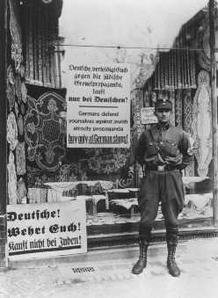
APRIL 1, 1933: NATIONWIDE BOYCOTT OF JEWISH-OWNED BUSINESSES At 10:00 a.m., SA and SS members stand in front of Jewish-owned businesses throughout Germany to inform the public that the proprietors of these establishments are Jewish. The word "Jude," German for "Jew," is often smeared on store display windows, with a Star of David painted in yellow and black across the doors. Anti-Jewish signs accompany these slogans. The official boycott ends at midnight.
During the anti-Jewish boycott, an SA man stands outside a Jewish-owned store with a sign demanding that Germans not buy from Jews. Berlin, Germany, April 1, 1933.
http://www.ushmm.org/wlc/en/media_ph.php?MediaId=2675

Slide 3
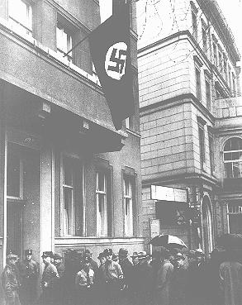
APRIL 7, 1933: LAW DISMISSES JEWS FROM CIVIL SERVICE Law for the Reestablishment of the Professional Civil Service removes Jews from Government Service As a result, civil service employees are forced to prove their "Aryan" descent by documenting the religion of their parents and grandparents. If unable to do so, they are dismissed from service. Similar laws passed in the following weeks affect Jewish lawyers and doctors. Law on the Admission to the Legal Profession forbids the admission of Jews to the bar.
Jewish lawyers line up to apply for permission to appear before the Berlin courts. Berlin, Germany, April 11, 1933
http://www.ushmm.org/wlc/en/media_ph.php?ModuleId=10005681&MediaId=476

Slide 4
JULY 14, 1933
Law for the Prevention of Progeny with Hereditary Diseases De-Naturalization Law revokes the citizenship of naturalized Jews and “undesirables.”

Slide 5
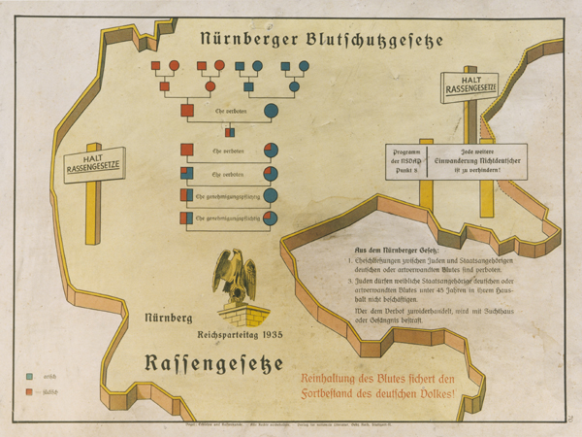
SEPTEMBER 15, 1935: NUREMBERG LAWS ARE INSTITUTED At their annual party rally, the Nazis announce new laws that revoke Reich citizenship for Jews and prohibit Jews from marrying or having sexual relations with persons of "German or related blood." "Racial infamy” is made a criminal offense. The Nuremberg Laws define a "Jew" as someone with three or four Jewish grandparents. TheNazis classify as Jews people who had converted from Judaism to another religionwhose grandparents were Jewish.
"The Nuremberg Law for the Protection of Blood and German Honor." The illustration is a stylized map of the borders of central Germany on which is imposed a schematic of the forbidden degrees of marriage between Aryans and non-Aryans. The German text at the bottom reads, "Maintaining the purity of blood insures the survival of the German people."
http://www.ushmm.org/outreach/en/article.php?ModuleId=10007695

Slide 6
OCTOBER 18, 1935: NEW MARRIAGE REQUIREMENTS INSTITUTED The "Law for the Protection of the Hereditary Health of the German People" requires all prospective marriage partners to obtain from the public health authorities a certificate of fitness to marry. Such certificates are refused to those suffering from "hereditary illnesses" and contagious diseases and those attempting to marry in violation of the Nuremberg Laws.
http://www.ushmm.org/outreach/en/article.php?ModuleId=10007695

Slide 7
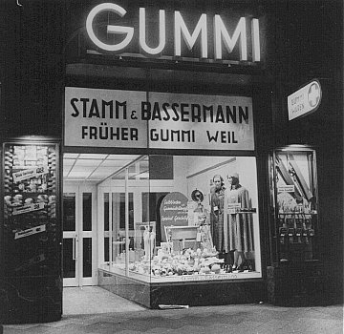
"ARYANIZATION"
Government agencies at all levels aimed to exclude Jews from the economic sphere of Germany by preventing them from earning a living. Jews were required to register their domestic and foreign property and assets. German authorities intended to "Aryanize" all Jewish businesses, a process involving the dismissal of Jewish workers and managers, as well as the transfer of companies and enterprises to non-Jewish Germans, who bought them at prices officially fixed well below market value. From April 1933 to April 1938, "Aryanization" effectively reduced the number of Jewish-owned businesses in Germany by approximately two-thirds.
A formerly Jewish-owned store (Gummi Weil) expropriated and transferred to non-Jewish ownership (Stamm and Bassermann). Frankfurt, Germany, 1938.
http://www.ushmm.org/wlc/en/media_ph.php?ModuleId=10005681&MediaId=2692

Slide 8
AUGUST 17, 1938: JEWS REQUIRED TO ASSUME "JEWISH" NAME The German government requires all Jews in Germany whose first name is not immediately recognizable as Jewish to add a "Jewish" name following their first name. Men are required to add "Israel" and women "Sara." In October, the German government confiscates all passports held by Jews. New passports issued to Jews have a "J" stamped on them, indicating that the holder is Jewish.
Passport issued to Lore Oppenheimer, a German Jew, with "J" for "Jude" stamped on the card. Hildesheim, Germany, July 3, 1939.
http://www.ushmm.org/outreach/en/article.php?ModuleId=10007703

Slide 9
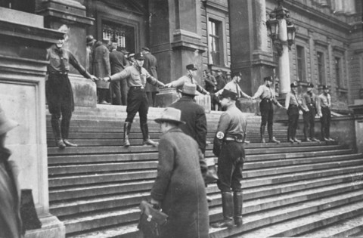
NOVEMBER 15, 1938
Reich Ministry of Education expels all Jewish children from public schools.
Preceded by:
APRIL 25, 1933
Law against Overcrowding in Schools and Universities limits the number of Jewish students in public schools.
APRIL 9, 1937
The Mayor of Berlin orders public schools not to admit Jewish children until further notice.
Nazis block Jews from entering the University of Vienna. Austria, 1938.
http://www.ushmm.org/wlc/en/media_ph.php?MediaId=2006

Slide 10
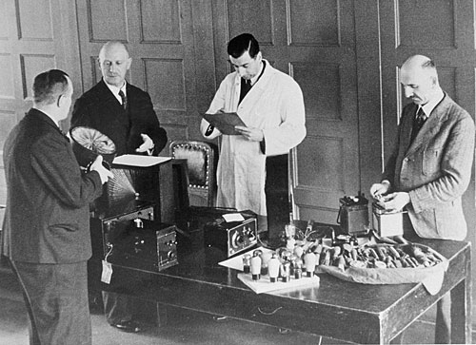
SEPTEMBER 1, 1939
Curfew on Jewish individuals and prohibited Jews from entering areas in many German cities.
Jews received reduced rations; further decrees limited the time periods in which Jews could purchase food.
German authorities also demanded that Jews relinquish property “essential to the war effort” such as radios, cameras, bicycles, electrical appliances, and other valuables, to local officials.
http://www.ushmm.org/propaganda/archive/german-jews-surrender-radios/

Slide 11
SEPTEMBER 1941
Decree prohibited Jews from using public transportation.
While ghettos were generally not established in Germany, strict residence regulations forced Jews to live in designated areas of German cities, concentrating them in “Jewish houses” (“Judenhäuser”).
German authorities issued ordinances requiring Jews fit for work to perform compulsory forced labor.

Slide 12
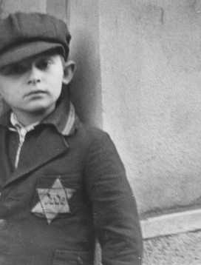
SEPTEMBER 19, 1941: BADGE IDENTIFYING JEWS INTRODUCED IN GERMANY Jews over the age of six in Germany are required to wear a yellow, six-pointed star with the word "Jude" (German for "Jew") across the front in black, sewn to their outer clothing at all times. Jews are now identifiable on sight in Germany. Systematic deportations of Jews from Germany begin in October. In March 1942, Jews are also required to display the star symbol on their residences.
A Jewish boy wearing the compulsory Star of David. Prague, Czechoslovakia, between September 1941 and December 1944.
http://www.ushmm.org/outreach/en/article.php?ModuleId=10007703

Slide 13
1943
German authorities implemented the last major deportations of German Jews to Theresienstadt or Auschwitz
German justice authorities enacted a mass of laws and ordinances legitimizing the Reich's seizure of their remaining property and regulating its distribution among the German population.
The persecution of Jews by legal decree ended with a July 1943 ordinance removing Jews entirely from the protection of German law and placing them under the direct jurisdiction of the Reich Security Main Office (Reichssicherheitshauuptamt-RSHA).

