Slide 1
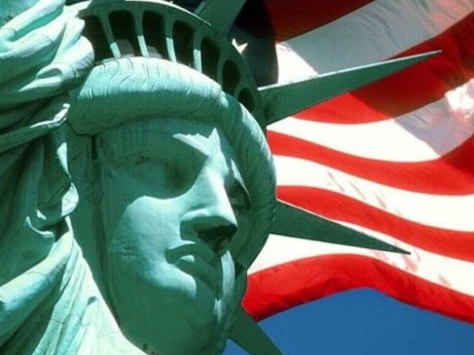
"Give me your tired, your poor, Your huddled masses yearning to breathe free, The wretched refuse of your teeming shore. Send these, the homeless, tempest-tossed to me, I lift my lamp beside the golden door!"

Slide 2
Factors which created barriers for Jewish refugees attempting to flee Nazi Germany and emigrate into the United States
1. Discriminatory immigrations laws (National Origins Act of 1924). This was influenced by:
Popular American attitudes of nativism, xenophobia, anti-immigration/restrictionist attitudes.
Widespread anti-Semitism in USA

Slide 3
Nativism, xenophobia and anti-immigrant sentiment in USA
Nativism- a policy of favoring native-born inhabitants over immigrants.
Nativism favored the interests of certain established inhabitants of the nation (white Protestant Anglo or Northern and Western European) as compared to claims of newcomers or immigrants (Catholics and Jews often from Southern and Eastern Europe) Many believed the new immigrants would change the racial stock and foundational characteristics of the nations- characteristics which made the nation great.
Nativism was a type of revitalization movement aimed at perpetuating, restoring, or reviving “traditional” cultural practices or characteristics, which were thought to be the source of the nation's strength and to be threatened or lost with waves of new “different” immigrants.
Nativism was characterized by the resurgence of a powerful Ku Klux Klan in the 1920s which was vehemently anti-immigrant and anti-Semitic.

Slide 4
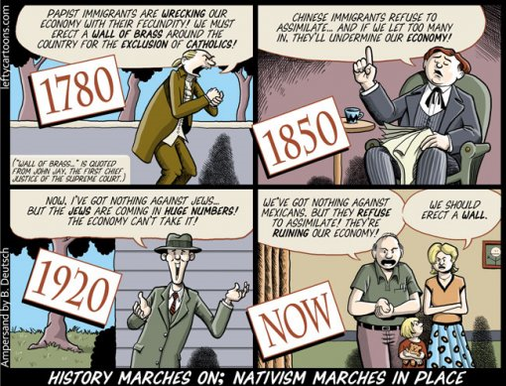

Slide 5
Ku Klux Klan 1920s
By 1925, KKK had more than 4 million members- more than entire Jewish population in America.
Members served in state legislatures and Congress, and were elected to the governorship in several states. Indiana, Oklahoma, Texas and Oregon saw significant Ku Klux Klan influence including numerous state officials.
After the First World War the Ku Klux Klan also became extremely hostile to Jews, Roman Catholics, socialists, communists and anybody they identified as “foreigners.”

Slide 6
In 1915, political and economical conditions were ideal for the rise of the second KKK. "Jewish bankers" and other foreigners were blamed for the decline in farming and marketing prices. This economic difficulty made the nation susceptible to the Klan's hate messages against all non-whites. Pro-Klan novels and movies, such as The Birth of a Nation, also inspired whites to form a new Klan.
Reaching its peak of over four million members, the Klan of the 1920s thrived on nativism, anti-Catholicism, anti-Semitism, opposition to the cultural modernism of the Jazz Era, and violations of alcohol, smoking, and gambling laws. Directing their hate tactics toward Catholics, Jews, and foreign-born, the Klan used tarring and feathering, branding, mutilating, and lynching (hanging) to install fear.

Slide 7
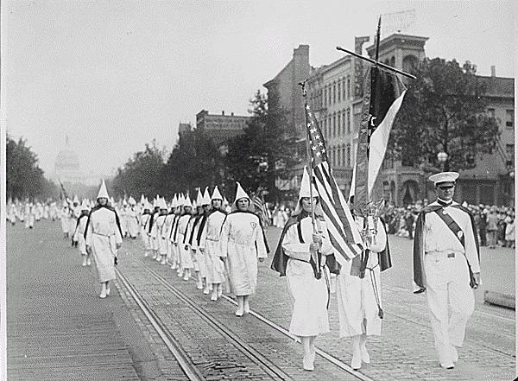
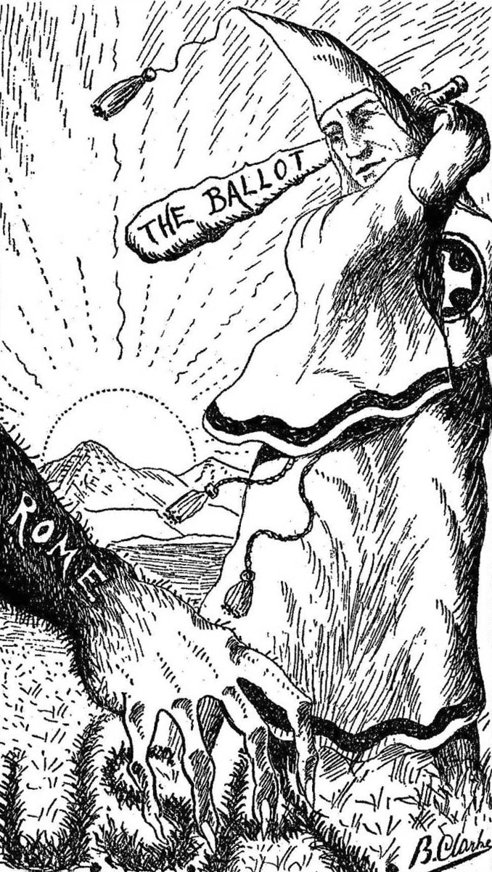
Above: Ku Klux Klan members march down Pennsylvania Avenue in Washington, D.C. in 1928

Slide 8
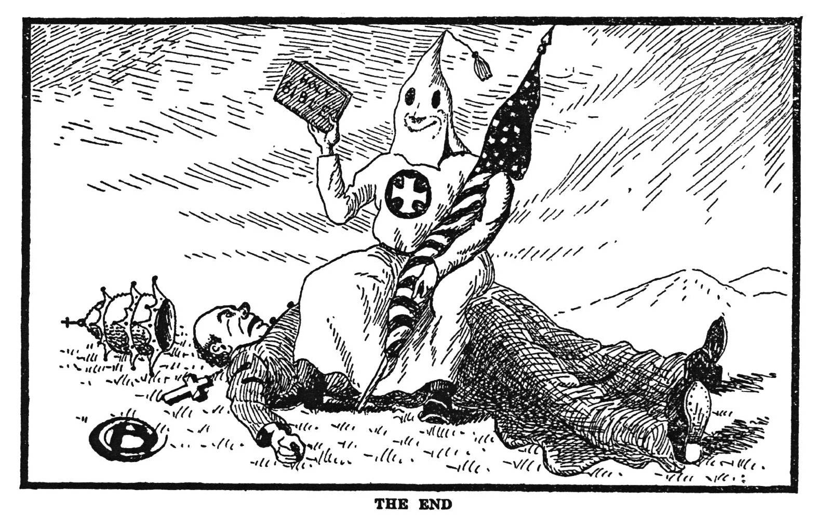
"The End" Referring to the end of Catholic influence in the US. Klansmen: Guardians of Liberty 1926

Slide 9
National Origins Act 1924
During the Harding administration, a stop-gap immigration measure was passed by Congress in 1921 for the purpose of slowing the flood of immigrants entering the United States.
A more thorough law (National Origins Act) was signed by President Coolidge in May 1924. It provided for the following:
The quota for immigrants entering the U.S. was set at two percent of the total of any given nation's residents in the U.S. as reported in the 1890 census;
after July 1, 1927, the two percent rule was to be replaced by an overall cap of 150,000 immigrants annually and quotas determined by "national origins" as revealed in the 1920 census.
The clear aim of this law was to restrict the entry of immigrants from Southern and Eastern Europe, while welcoming relatively large numbers of newcomers from Britain, Ireland, and Northern Europe.
The 1921 law had used the 1910 census to determine the base for the quotas; by changing to the 1890 census when fewer Italians, Southern and Eastern Europeans lived in the U.S., more of the "dangerous' and "different" elements were kept out. This legislation reflected discriminatory sentiments that had surfaced earlier during the Red Scare of 1919-20.

Slide 10
National Origins Act
In 1924 Congress passed a discriminatory immigration law that restricted the immigration of Southern and Eastern Europeans and practically excluded Asians and other nonwhites from entry into the United States. This act instituted admission quotas by using the 1890 census to determine the population of a particular nationality group; the government then only allowed 2 percent of that population into the nation. In addition, the act completely barred immigration for all those whom the Supreme Court prohibited from obtaining U.S. citizenship, specifically Asians. The National Origins Act drastically lowered the annual quota of immigration, from 358,000 to 164,000. Congress abolished the national origins quota system in the 1960s

Slide 11
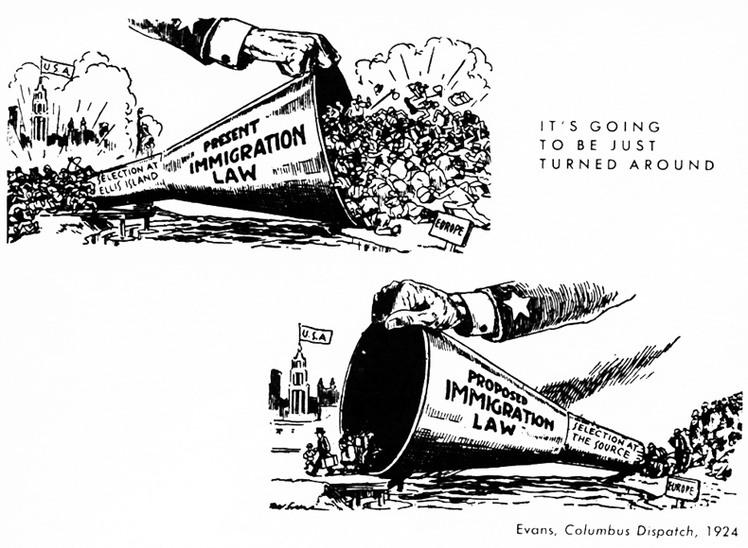

Slide 12
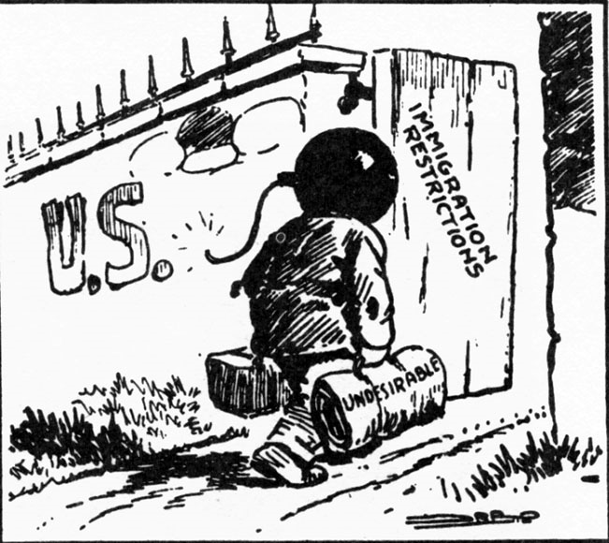

Slide 13
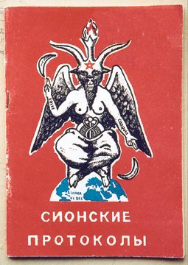
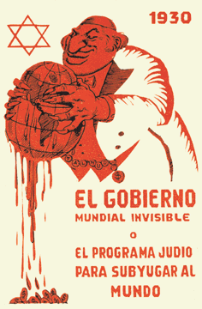
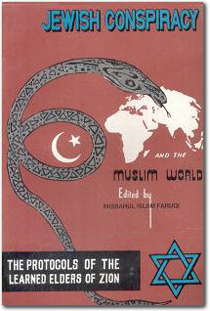
Spanish edition of the The Protocols, 1930: “The Invisible World
Government, or the Jewish Program to Subjugate the World”
Original Russian edition of The Protocols, 1911
Pakistani edition of The Protocols, 1969
One Lie, Many Versions

Slide 14
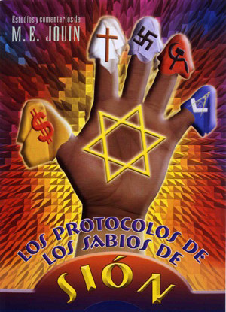
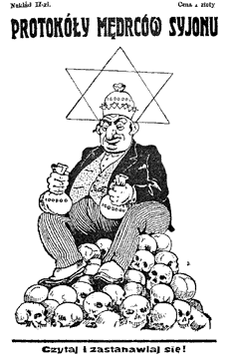
Egyptian edition of The Protocols, 2003: “The Protocols of theElders of Zion and their Biblical and Talmudic Origins”
Mexican edition of The Protocols, 2005
Polish edition of The Protocols, 1943
One Lie, Many Versions

Slide 15
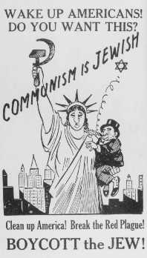
Antisemitic poster equating Jews with communism. United States, 1939.
— Jewish War Veterans Museum

Slide 16
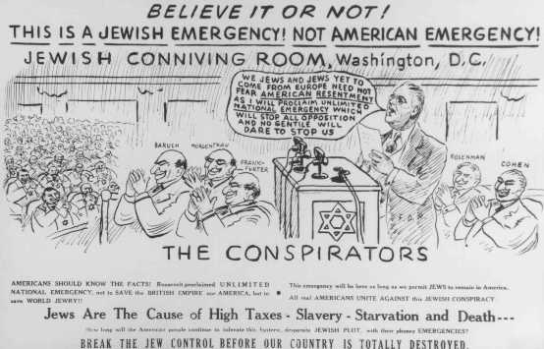
Antisemitic propaganda. United States, date uncertain.
— National Museum of American Jewish History, Philadelphia

Slide 17
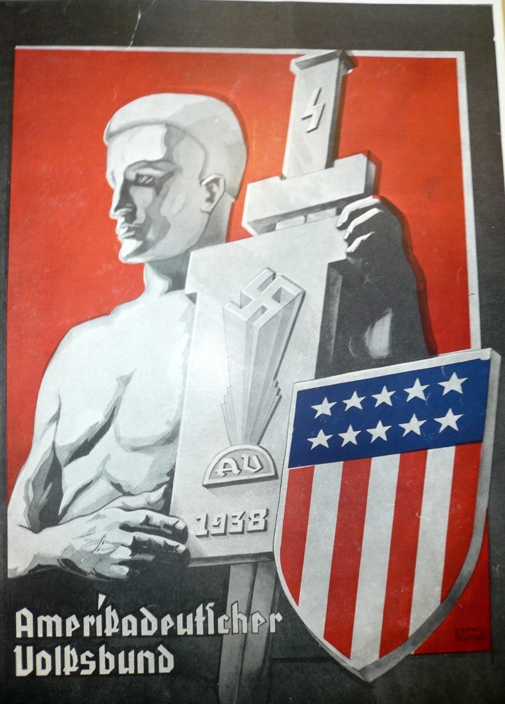
The German American Bund attempted to reconcile American patriotism with National Socialism. They were the most feared anti-Semitic organization in America in the 1930s.

Slide 18
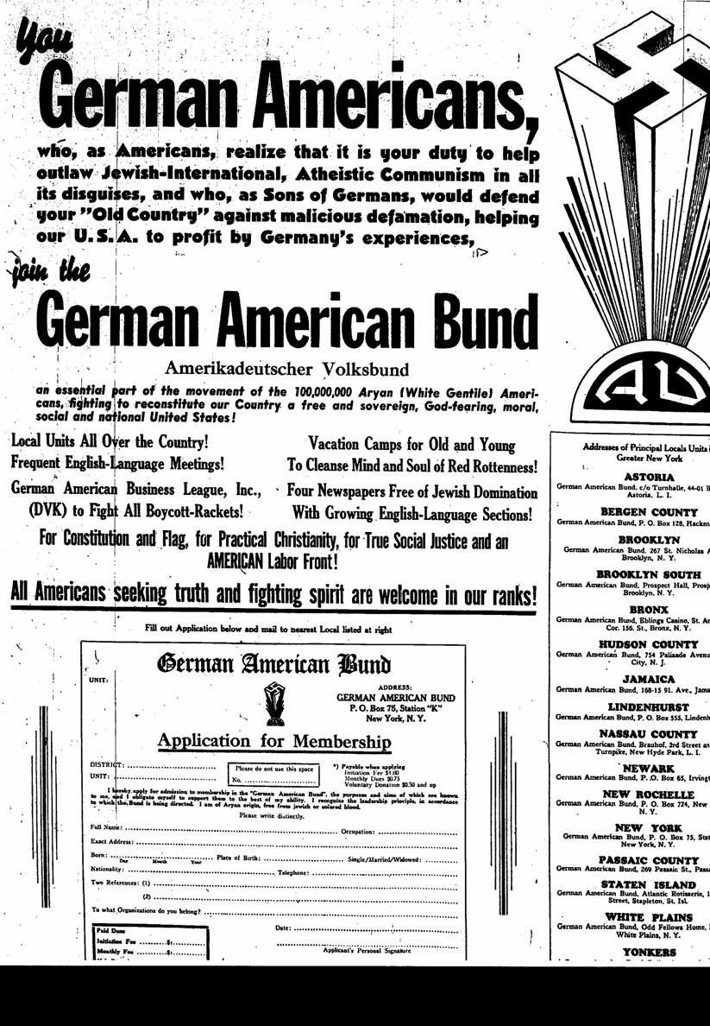
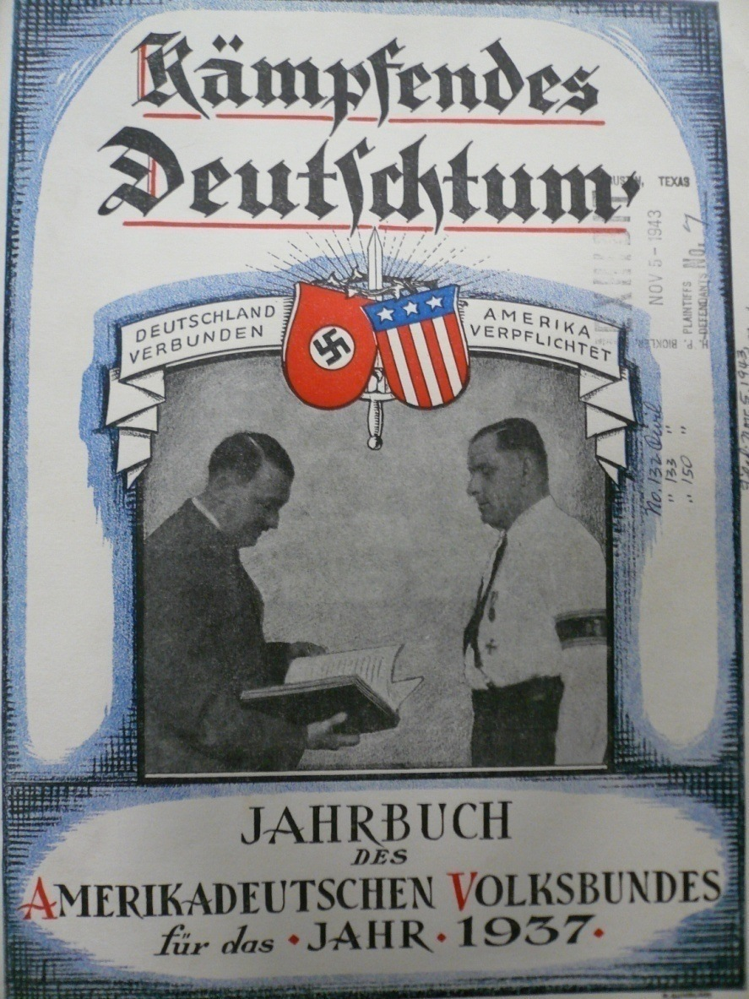
The German American Bund
Membership application to the German American Bund
In 1936, Bund leader Fritz Kuhn visited Germany. Here, Hitler accepts a gift from Kuhn and takes a photo with the “American Fuehrer.”

Slide 19
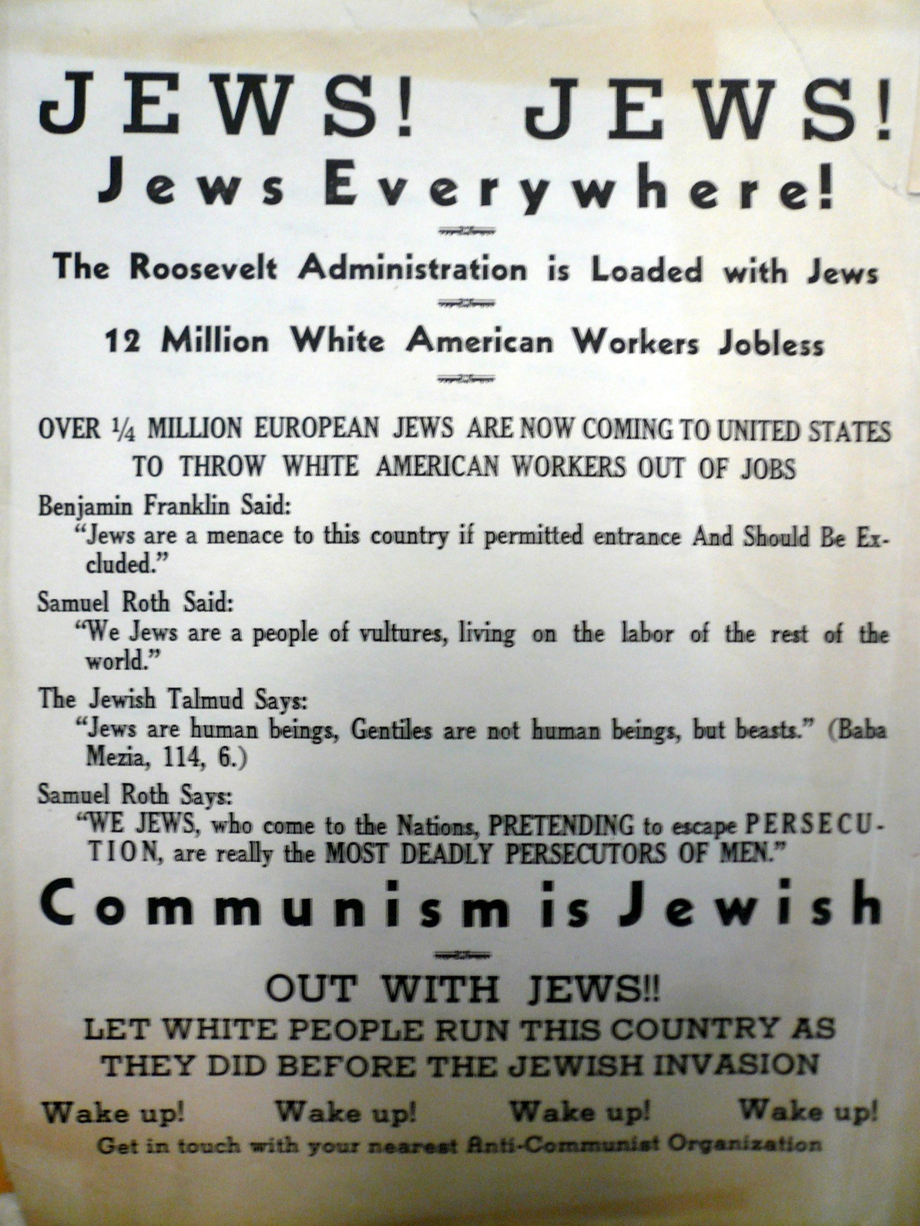
Anti-Semitic propaganda distributed by the German American Bund

Slide 20
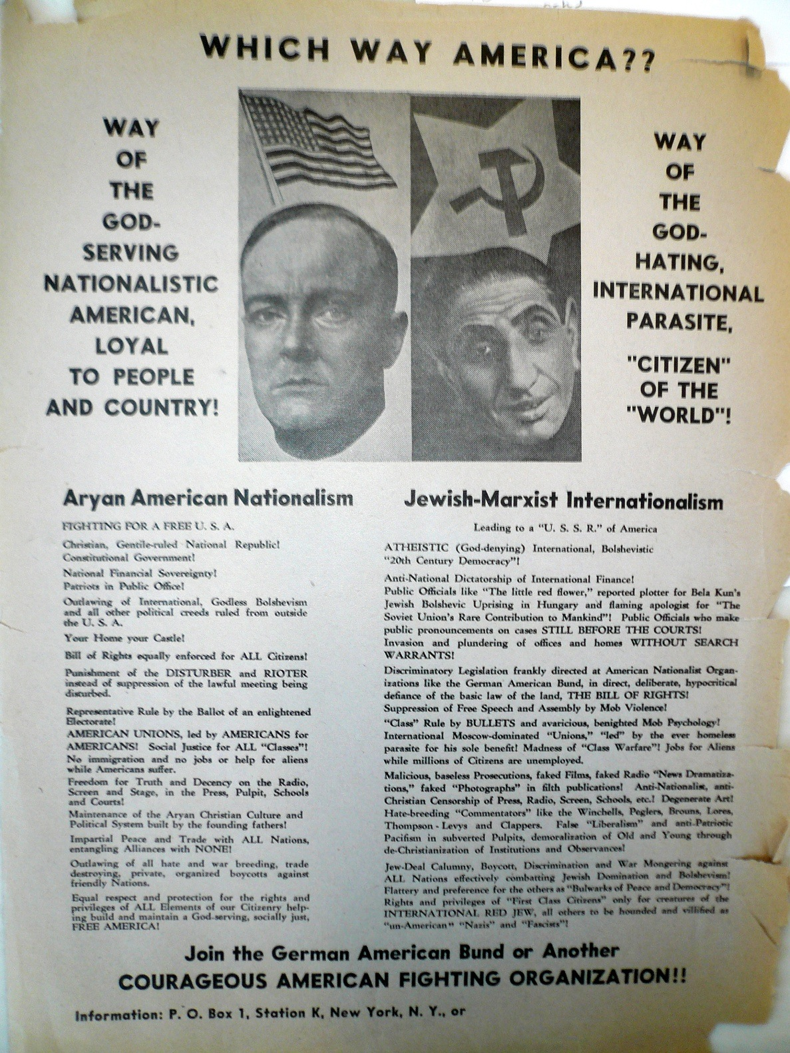
Anti-Semitic propaganda distributed by the German American Bund. The Bund played on familiar themes like accusing Jews of a “communist conspiracy.”

Slide 21
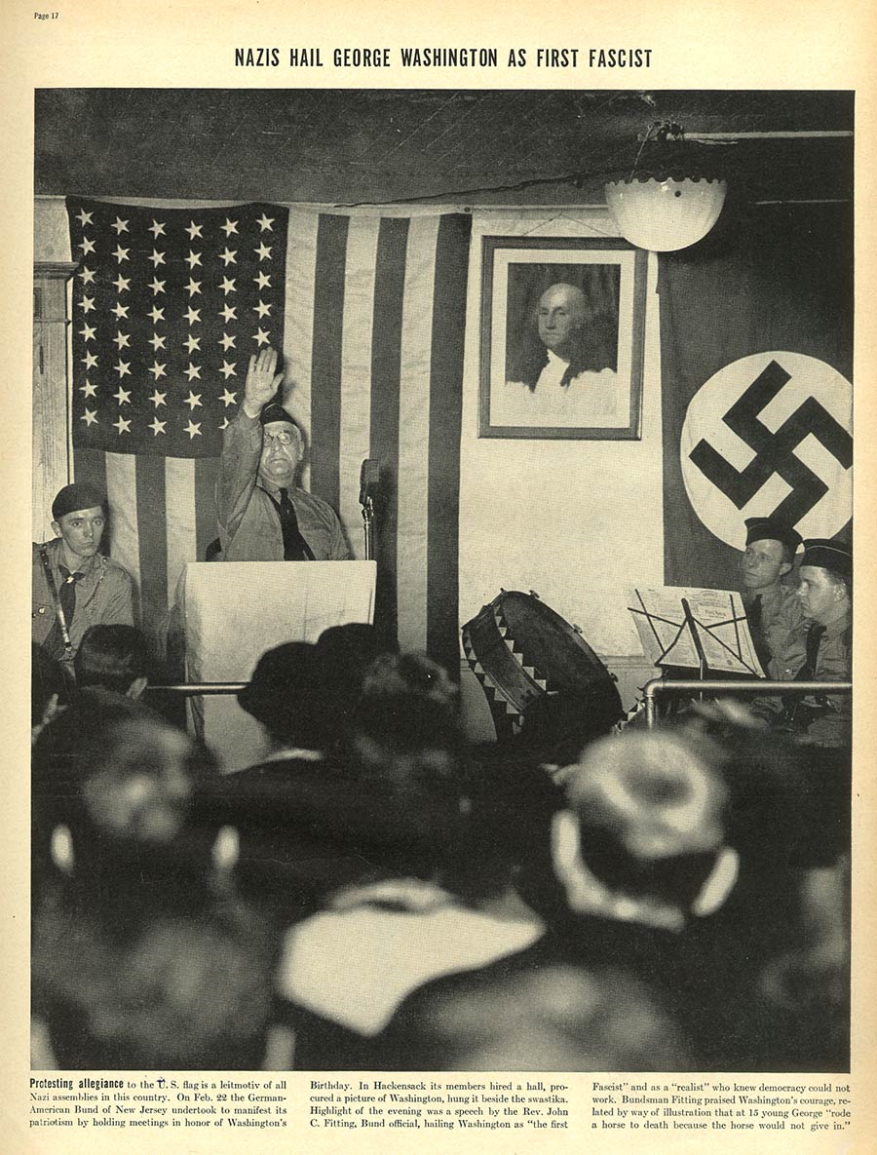
The German American Bund proclaimed that they were fighting for America by imitating the ways of the Nazis.

Slide 22
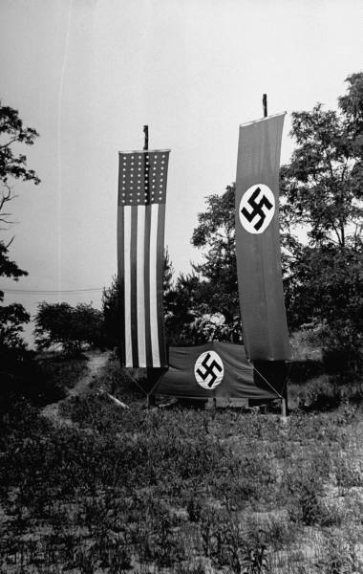
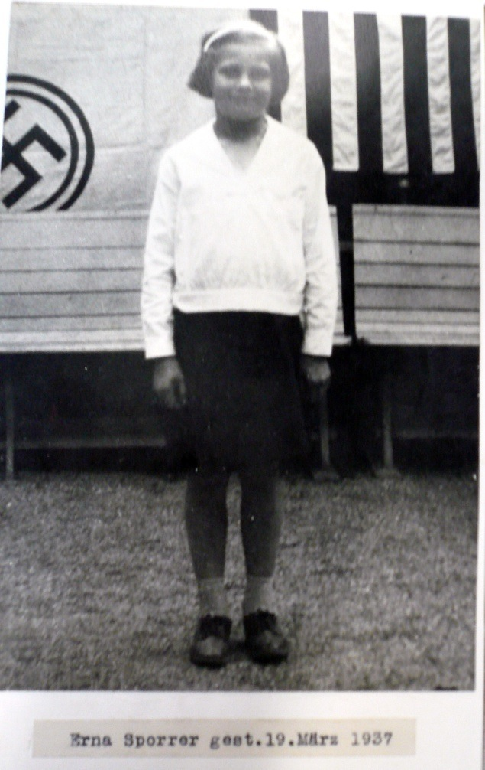
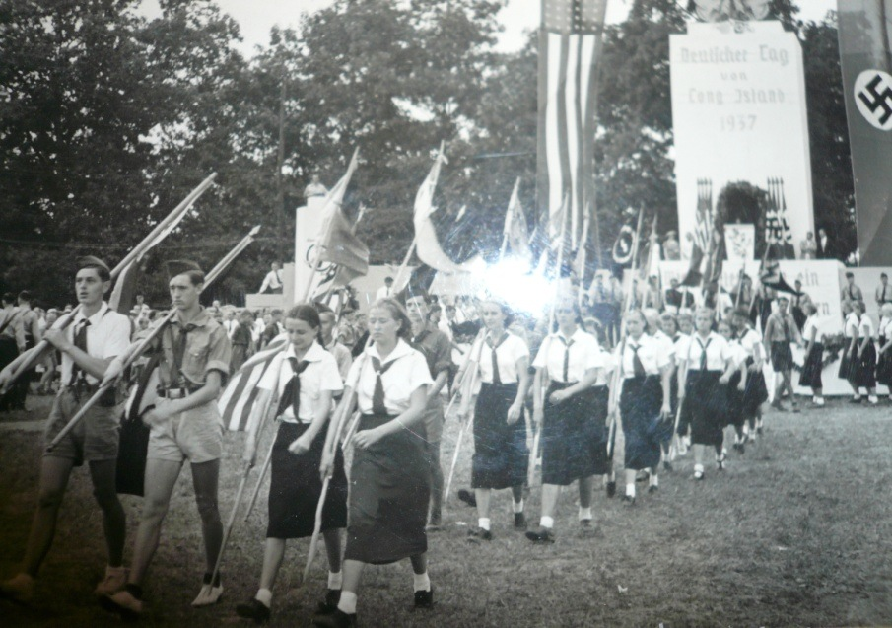
The German American Bund operated several recreational camps and enrolled children in programs modeled after the Hitler Youth. Camp Nordland in Andover, NJ was their largest camp.

Slide 23
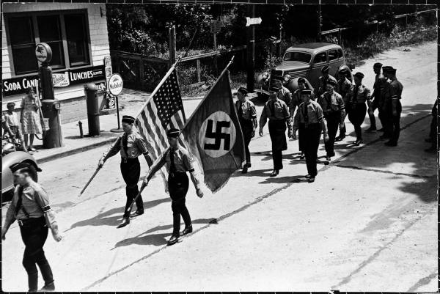
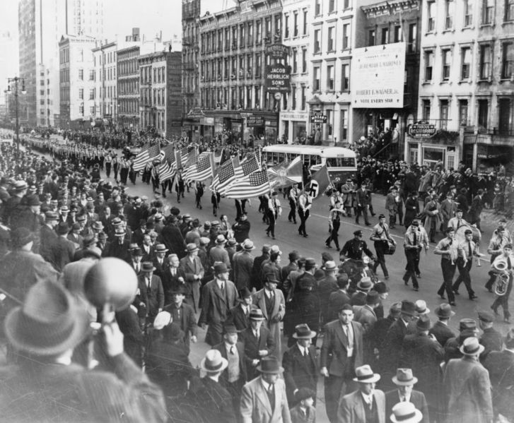
German American Bund parade on East 86th St., New York City, October 30, 1939

Slide 24
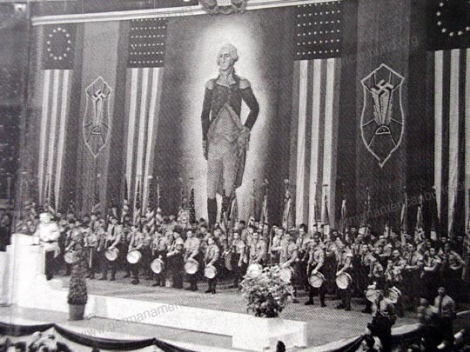
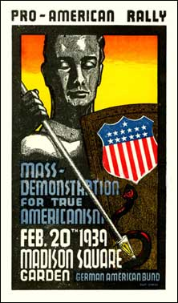
The German American Bund at their peak of notoriety: the 1939 Madison Square Garden rally attended by 25,000 Bundists and sympathizers.

Slide 25
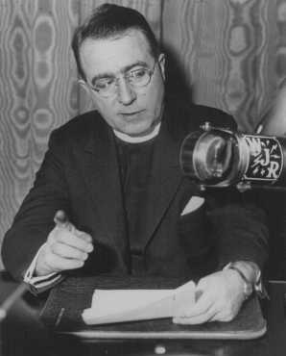
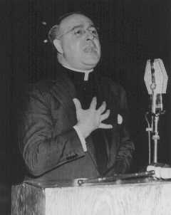
Father Charles E. Coughlin, the “Radio Priest”

Slide 26
Father Charles E. Coughlin, the “Radio Priest”
Father Charles Coughlin occupied both a strange and a familiar place in American politics in the 1930s. Politically radical, a passionate democrat, he nevertheless was a bigot who freely vented angry, irrational charges and assertions. A Catholic priest, he broadcast weekly radio sermons that by 1930 drew as many as forty-five million listeners.
Strongly egalitarian, deeply suspicious of elites, a champion of what he saw as the ordinary person’s rights, Coughlin frequently and vigorously attacked capitalism, communism, socialism, and dictatorship. By the mid-1930s, his talks took on a nasty edge as he combined harsh attacks on Roosevelt as the tool of international Jewish bankers with praise for the fascist leaders Benito Mussolini and Adolph Hitler.
Coughlin had a powerful impact on American politics beyond his immediate radio audience.

Slide 27
Charles Coughlin, radio broadcast (5th June, 1939)
“When, either in speech or writing, have I advocated Nazism? It is true that I have regarded it as a defense mechanism against Communism. It is true - this following statement is supported by incontestable facts - that many Jews were among those responsible for furthering Communism in Germany and bringing that country to such a despondent state that Nazism became a reality.”

Slide 28
Coughlin Quotes
"If Jews persist in supporting communism directly or indirectly, that will be regrettable. By their failure to use the press, the radio and the banking house, where they stand so prominently, to fight communism as vigorously as they fight Naziism, the Jews invite the charge of being supporters of communism." -- November 28, 1938

Slide 29
Coughlin Quotes
“The average Jew, the kind we admire and respect, has been placed in jeopardy by his guilty leaders. He pays for their Godlessness, their persecution of Christians, their attempts to poison the whole world with Communism.”
On December 18, 1938 two thousand of Coughlin's followers marched in New York protesting potential changes to the asylum law that would allow more Jews (including refugees from Hitler's persecution) into the U.S., chanting, "Send Jews back where they came from in leaky boats!" and "Wait until Hitler comes over here!"

Slide 30
Coughlin Quotes
"Must the entire world go to war for 600,000 Jews in Germany who are neither American, nor French, nor English citizens, but citizens of Germany?“- Jan. 30, 1939
"If Jews persist in supporting communism directly or indirectly, that will be regrettable. By their failure to use the press, the radio and the banking house, where they stand so prominently, to fight communism as vigorously as they Nazism, the Jews invite the charge of being supporters of communism."
"From European entanglements, from Nazism, communism and their future wars, America must stand aloof. Keep America safe for Americans and the Stars and Stripes the defender of God."
"When we get through with the Jews in America, they'll think the treatment they received in Germany was nothing."
"Jewish persecution only followed after Christians first were persecuted."

Slide 31
Father Charles E. Coughlin, the “Radio Priest”
At a speech Coughlin gave in the Bronx – perhaps his most famous – he gave a Nazi salute and yelled out, "When we get through with the Jews in America, they'll think the treatment they received in Germany was nothing." Proving this statement wasn't a one-time lapse of judgment, Coughlin stated "Jewish persecution only followed after Christians first were persecuted," after the 1938 Kristallnacht pogrom in Germany.
His speeches and programs were becoming even more anti-Semitic from that point, and radio stations in New York and Chicago began refusing to air his content without first pre-approving his scripts. One of the only available stations for Coughlin was the small WHBI in Newark, New Jersey.
Father Coughlin's anti-Semitism made him a hero in Nazi Germany, where newspapers ran daily, stating that "America is not allowed to hear the truth." Some of the American public shared Coughlin's views, and 2,000 supporters gathered and marched in New York, protesting the migration of Jewish refugees from Hitler's camps. These protests were not short-lived; they went on for several months, and Coughlin embraced his supporters.
At the height of his anti-Semitism, Coughlin had joined forces with an organization named the "Christian Front," which cited the now-famous priest as a vital influence. In 1940, the FBI shut down the Christian Front, after discovering the group was arming itself and planning to murder Jews, communists, and even United States Congressmen. Although Father Coughlin was never directly linked with the Christian Front, he never disassociated himself from their radical intentions. His reputation soon declined as a result.

Slide 32
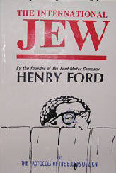
First Appearance in the United States
The Protocols were publicized in the U.S. by Boris Brasol, who had
been a lawyer in Czarist Russia. Auto mogul Henry Ford was one of
those who took interest. The Dearborn Independent, a newspaper
owned by Ford, published an American version of The Protocols
between May and September of 1920 in a series called “The
International Jew: the World’s Foremost Problem.” The articles were
later republished in book form with half a million copies distributed in
the U.S., and were translated into several foreign languages.
Several years later Ford apologized for the “International Jew,” but
hundreds of thousands of people around the world had already been
encouraged to accept The Protocols as truth.

Slide 33
Charles Lindbergh
Their greatest danger lies in (the Jews') large ownership and influence in our motion pictures, our press, our radio, and our Government... We cannot blame them for looking out for what they believe to be their interests, but we also must look out for ours. - Charles Lindbergh, September 11, 1941
a strongly isolationist group called America First was gaining a strong following, having 850,000 members by early 1941. To put this in perspective, this is equivalent to a single anti-war organization today having a membership of around 1.8 million, an almost inconceivable number.

Slide 34
Charles Lindbergh
Lindbergh became a spokesperson for America First. He was a man who was largely viewed as an American hero for conducting the first trans-Atlantic flight fourteen years earlier. He had lived abroad for several years following the kidnapping of his son in 1932, returning to the United States in 1939 to lend support to the large anti-war movement.
In 1936, he inspected Germany's military aviation program and in August attended the Summer Olympic Games in Berlin as a guests of Nazi Hermann Goering, the head of the Luftwaffe. Impressed by German industry and society under Adolf Hitler, the Lindberghs considered moving to Berlin.
In 1938, Goering presented Lindbergh with the Service Cross of the German Eagle for his contributions to aviation. Returning to America in 1939, Lindbergh became an advocate of American isolationism, but was criticized for his Nazi sympathies and anti-Semitic beliefs.

