Slide 1
Nazi Policy of Inclusion and Exclusion
Cornerstone of Nazi ideology and propaganda was that of the Volksgemeinschaft, or “national community” - an organic, racial union of all “Aryan” Germans that would transcend class, religious and regional differences. Individual rights were deemphasized in favor of stressing sacrifice for the good of the “national community”.
To accomplish the goals of the “national community,” the Nazis emphasized the policy Gleischaltung, the coordinating of all society around Nazi values. “Working towards the Fuehrer.”
Consequently, all those NOT in the national community must be excluded or removed for the health of the national community.

Slide 3
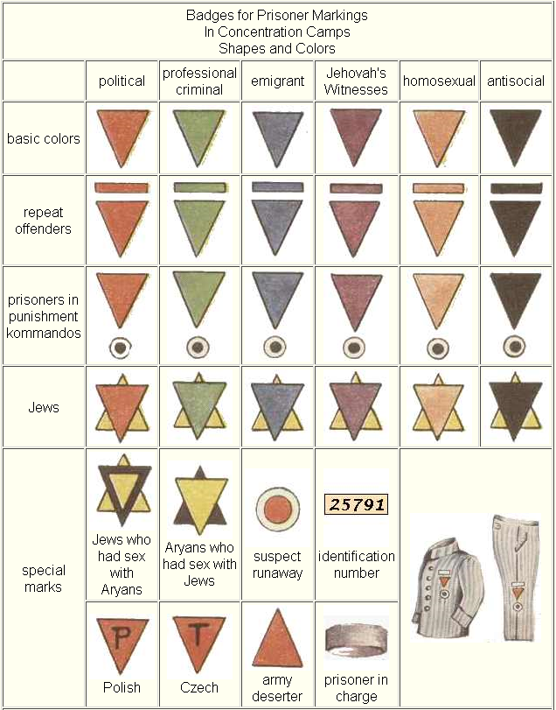

Slide 4
Concentration Camps and Death Camps
The Nazis built their order on the bedrock of an enormous and highly complex concentration and destruction system. These camps were an essential part of the Nazis' systematic oppression and mass murder of Jews, political adversaries, and others considered socially and racially undesirable.
There were concentration camps, forced labor camps, extermination or death camps, transit camps, and prisoner-of-war camps. The living conditions of all camps were brutal.
concentration camps increasingly became places where the enemies of the Nazis were killed, enslaved, starved, and tortured

Slide 5
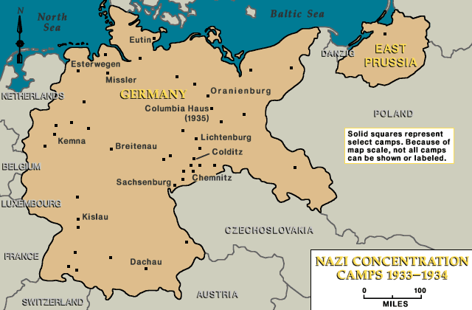
Nazi concentration camps, 1933-1934 The first concentration camps in Germany were established soon after Adolf Hitler's appointment as chancellor in January 1933. The Storm Troopers (SA) and the police established concentration camps beginning in February 1933. These camps were set up to handle the masses of people arrested as alleged political opponents. They were established on the local level throughout Germany. Gradually, most of these early camps were disbanded and replaced by centrally organized concentration camps under the exclusive jurisdiction of the SS (Schutzstaffel; the elite guard of the Nazi state). Dachau was the only concentration camp opened in 1933 that remained in operation until 1945, and was the model for the Nazi concentration camp system that replaced the earlier camps.

Slide 6
The Death Camps
Nazis build “extermination factories” in order to implement the mass murder of the Final Solution
Most six death camps: Auschwitz, Sobibor, Treblinka, Majdanek, Belzec, Chelmno.
Efficient, well coordinated killing effort on an unprecedented scale
Industrial methods to produce factories of mass murder.

Slide 7
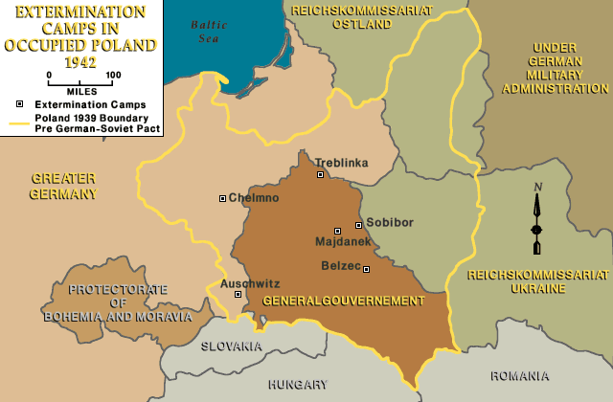

Slide 8
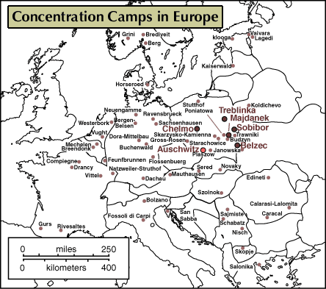

Slide 9
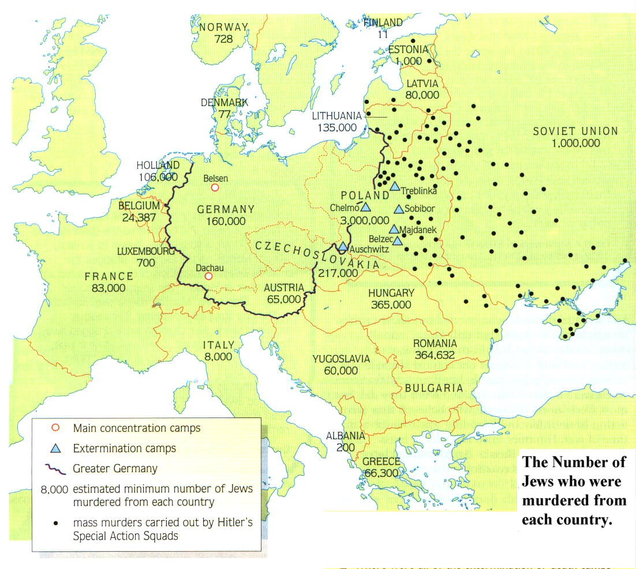
Where were the Death Camps built?
The work of the Einsatzgruppen
Why do you think that they located them here?
Notes:
Remember that the black dots represent the work of the Einsatzgruppen

Slide 10
