Slide 1
Holocaust & WWII Timeline
*all photos and texts are from USHMM’s website.

Slide 2
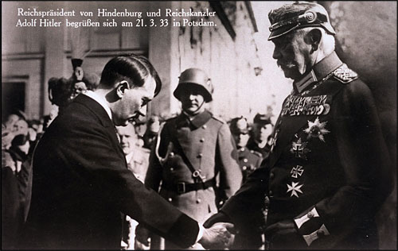
January 30, 1933: President Hindenburg appoints Adolf Hitler Chancellor of Germany
Adolf Hitler greets President Paul von Hindenburg, March 21, 1933
Recently appointed as German chancellor, Adolf Hitler greets President Paul von Hindenburg in Potsdam, Germany, on March 21, 1933. Hitler appears in civilian dress, bowing in deference to the heavily decorated von Hindenburg. The March 5, 1933, elections had conferred legitimacy on Hitler's leadership
http://www.ushmm.org/propaganda/archive/hitler-hindenburg/

Slide 3
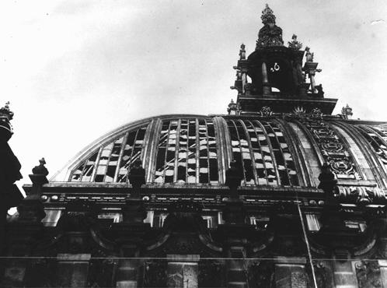
February 27, 1933: The Reichstag Fire
Dome of the Reichstag building, virtually destroyed by fire on February 27, 1933.
Hitler used the arson to convince President Hindenburg to declare a state of emergency. The government falsely portrayed the fire as part of a Communist effort to overthrow the state. They exploited the Reichstag fire to secure President von Hindenburg’s approval for an emergency decree, the Decree for the Protection of the People and the State of February 28. Popularly known as the Reichstag Fire Decree, the regulations suspended the right to assembly, freedom of speech, freedom of the press, and other constitutional protections, including all restraints on police investigations.
http://www.ushmm.org/wlc/en/article.php?ModuleId=10007657

Slide 4
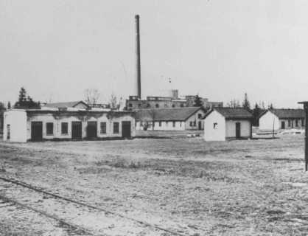
March 20, 1933: SS opens the Dachau concentration camp outside of Munich
View of barracks and the ammunition factory in one of the first photos of Dachau concentration camp. Dachau, Germany, March or April 1933.
Established in March 1933, the Dachau concentration camp was the first regular concentration camp established by the National Socialist (Nazi) government. Heinrich Himmler, in his capacity as police president of Munich, officially described the camp as "the first concentration camp for political prisoners.“The first prisoners arrive on March 22. They are mainly Communists and Socialists. Dachau is the only camp to remain in operation from 1933 until 1945.
http://www.ushmm.org/wlc/en/article.php?ModuleId=10005214

Slide 5
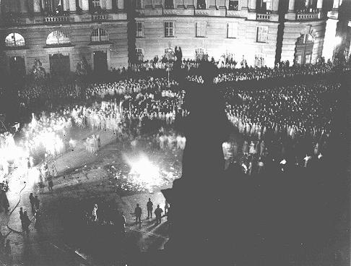
May 10, 1933: The burning of “Un-German” books
Crowds gather at Berlin's Opernplatz for the burning of books deemed "un-German." Berlin, Germany, May 10, 1933.
In a symbolic act of ominous significance, university students burned upwards of 25,000 volumes of “un-German” books, presaging an era of state censorship and control of culture. On the evening of May 10, in most university towns, right-wing students marched in torchlight parades “against the un-German spirit.” At the meeting places, students threw the pillaged and “unwanted” books onto bonfires with great ceremony, band-playing, and so-called “fire oaths.”
http://www.ushmm.org/wlc/en/article.php?ModuleId=10005852

Slide 6
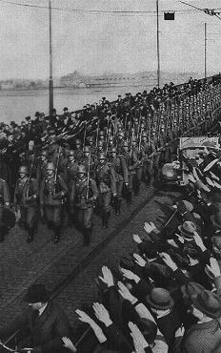
March 7, 1936: German troops march unopposed into the Rhineland
During the remilitarization of the Rhineland, German civilians salute German forces crossing the Rhine River in open violation of the Treaty of Versailles. Mainz, Germany, March 7, 1936.
Hitler ordered the German armed forces (Wehrmacht) into the demilitarized Rhineland. Hitler's action brought condemnation from Britain and France, but neither nation intervened.
http://www.ushmm.org/wlc/en/article.php?ModuleId=10005439

Slide 7
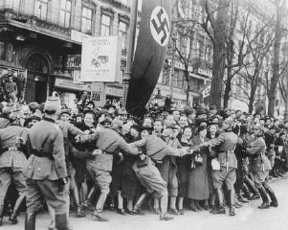
March 11-13, 1938: Germany incorporates Austria in the Anschluss (Union)
Cheering crowds greet Hitler as he enters Vienna. Austria, March 1938.
After a prolonged period of economic stagnation, political dictatorship, and intense Nazi propaganda inside Austria, German troops entered the country on March 12, 1938. They received the enthusiastic support of most of the population. Austria was incorporated into Germany the next day.
http://www.ushmm.org/wlc/en/article.php?ModuleId=10005447

Slide 8
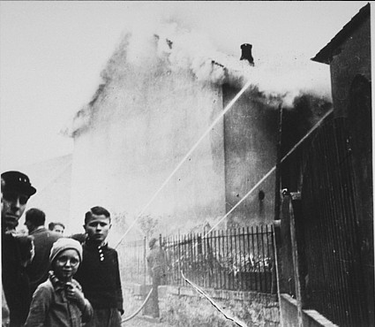
November 9, 1938: Kristallnacht, “Night of Broken Glass”
As a synagogue burns during Kristallnacht, firefighters instead save a nearby house. Residents watch as the synagogue is destroyed. Oberramstadt, Germany, November 9-10, 1938.
Violence against Jews broke out across the Reich. It appeared to be unplanned, but German propaganda minister Joseph Goebbels and other Nazis carefully organized the pogroms. In two days, over 250 synagogues were burned, over 7,000 Jewish businesses were trashed and looted, dozens of Jewish people were killed, and Jewish cemeteries, hospitals, schools, and homes were looted while police and fire brigades stood by.
http://www.ushmm.org/outreach/en/article.php?ModuleId=10007697

Slide 9
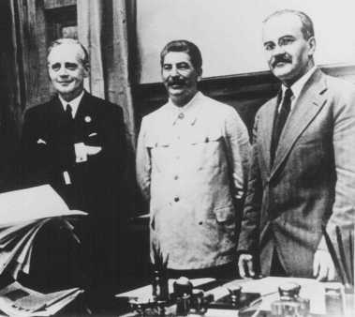
August 23, 1939: Nazi-Soviet Nonaggression Agreement
Nazi foreign minister Joachim von Ribbentrop (left), Soviet leader Joseph Stalin (center) and Soviet foreign minister Viacheslav Molotov (right) at the signing of the nonaggression pact between Germany and the Soviet Union. Moscow, August 1939.
The German-Soviet Pact had two parts. An economic agreement, signed on August 19, 1939, provided that Germany would exchange manufactured goods for Soviet raw materials. Nazi Germany and the Soviet Union also signed a ten-year nonaggression pact on August 23, 1939, in which each signatory promised not to attack the other.
http://www.ushmm.org/wlc/en/article.php?ModuleId=10005156

Slide 10
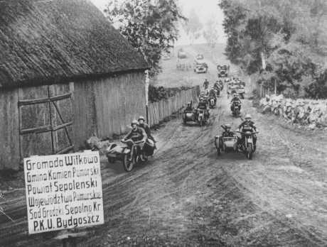
September 1, 1939: Germany invades Poland, starting World War II in Europe
Invading German troops approach Bydgoszcz. Poland, September 18, 1939.
After securing the neutrality of the Soviet Union, Germany started World War II by invading Poland on September 1, 1939. Britain and France responded by declaring war on Germany on September 3. Within a month, Poland was defeated by a combination of German and Soviet forces and was partitioned between Nazi Germany and the Soviet Union.
http://www.ushmm.org/wlc/en/article.php?ModuleId=10005137

Slide 11
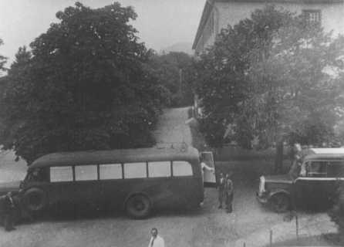
October 1939: Hitler authorizes killing of the impaired
Buses used to transport patients to Hadamar euthanasia center. The windows were painted to prevent people from seeing those inside. Germany, between May and September 1941.
Adolf Hitler authorizes the beginning of the "euthanasia" program -- the systematic killing of those Germans whom the Nazis deem "unworthy of life.“ At the beginning of World War II, individuals who were mentally retarded, physically handicapped, or mentally ill were targeted for murder in what the Nazis called the "T-4," or "euthanasia," program.
http://www.ushmm.org/outreach/en/article.php?ModuleId=10007683

Slide 12
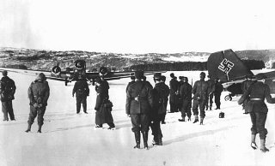
April 9, 1940: Germany invades Denmark and Norway
May 10, 1940: Germany attacks western Europe (France and the Low Countries)
German troops and bombers on an improvised airfield during the battle for Norway, May 3, 1940.
On April 8-9, 1940, Germany invaded Norway and Norway surrendered to Germany on June 10. The campaign against the Low Countries and France lasted less than six weeks. Germany attacked in the west on May 10, 1940. Belgium and the Netherlands surrendered in May. Paris fell to the Germans on June 14, 1940.
http://www.ushmm.org/wlc/en/article.php?ModuleId=10005460

Slide 13
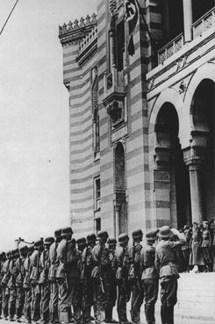
April 6, 1941: Germany invades Yugoslavia and Greece
A flag bearing a swastika is raised over the city hall in Sarajevo after German forces captured the city. Sarajevo, Yugoslavia, April 16, 1941.
The Axis powers invaded Yugoslavia on April 6, 1941. The immediate reason for the invasion of Yugoslavia was the Yugoslav government announcement that it would not honor its obligations under an agreement announced on March 25, 1941, by which Yugoslavia joined the Axis and would permit transit through its territory to German troops headed for Greece.
http://www.ushmm.org/wlc/en/article.php?ModuleId=10005456

Slide 14
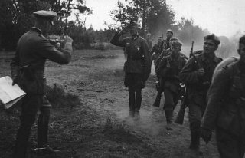
June 22, 1941: Germany invades the Soviet Union
German infantry during the invasion of the Soviet Union in 1941.
Under the codename Operation "Barbarossa," Nazi Germany invaded the Soviet Union on June 22, 1941 in the largest German military operation of World War II. The destruction of the Soviet Union by military force, the permanent elimination of the perceived Communist threat to Germany, and the seizure of prime land within Soviet borders for long-term German settlement had been a core policy of the Nazi movement since the 1920s.
http://www.ushmm.org/wlc/en/article.php?ModuleId=10005164

Slide 15
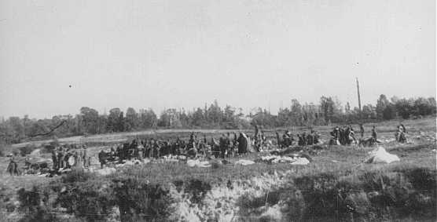
September 28-29, 1941: Einsatzgruppen shoot about 34,000 Jews at Babi Yar, outside Kiev
At Babi Yar, members of Einsatzgruppe C force groups of Jews to hand over their possessions and undress before being shot in the ravine. Near Kiev, September 29 or 30, 1941.
This was one of the largest mass murders at an individual location during World War II. As the victims moved into the ravine, Einsatzgruppe detachments shot them in small groups. According to reports by the Einsatzgruppe to headquarters, 33,771 Jews were massacred in two days.
http://www.ushmm.org/wlc/en/article.php?ModuleId=10005421

Slide 16
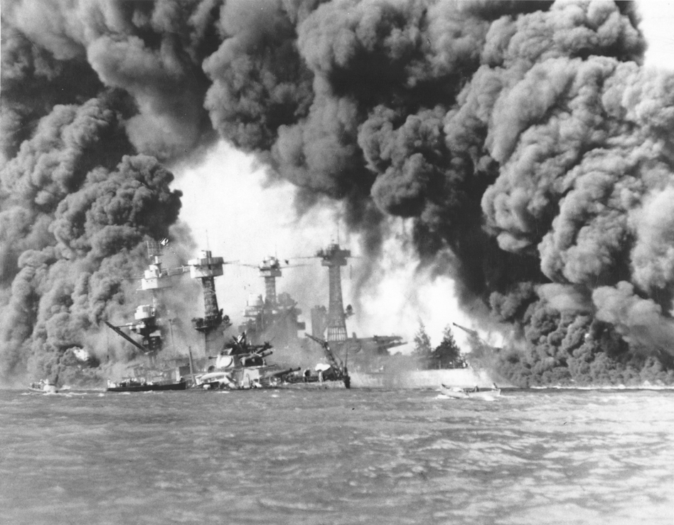
December 7, 1941: Japan bombs Pearl Harbor and the U.S. declares war the next day
Smoke billows out from U.S. ships hit during the Japanese air attack on Pearl Harbor.
Japan launched a surprise attack on the United States Pacific fleet at Pearl Harbor, Hawaii, on December 7, 1941. The attack severely damaged the American fleet and prevented, at least for the short term, serious American interference with Japanese military operations. In response, the United States declared war on Japan. Following Germany's declaration of war on the United States, the United States also declared war on Germany.
http://www.ushmm.org/wlc/en/article.php?ModuleId=10005155

Slide 17
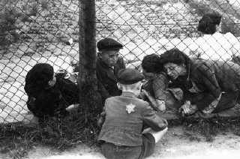
December 8, 1941: The first killing operations begin at Chelmno in occupied Poland
Family members say goodbye to a child through a fence at the ghetto's central prison before deportation to Chelmno during the "Gehsperre" action. Lodz, Poland, September 1942. Chelmno was located in the Wartheland administrative unit. SS and police authorities established the Chelmno killing center in order to annihilate the Jewish population of the Wartheland, including the inhabitants of the Lodz ghetto. It was the first stationary facility where poison gas was used for mass murder of Jews. On January 16, the Germans begin the mass deportation of more than 65,000 Jews from Lodz to the Chelmno killing center.
http://www.ushmm.org/wlc/en/article.php?ModuleId=10005194

Slide 18
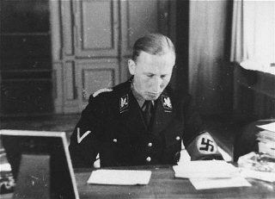
January 20, 1942: Wannsee Conference held near Berlin, Germany
SS General Reinhard Heydrich. Germany, date uncertain.
On January 20, 1942, 15 high-ranking Nazi Party and German government officials gathered at a villa in the Berlin suburb of Wannsee to discuss and coordinate the implementation of what they called the "Final Solution of the Jewish Question." In 1941 Hitler authorized this European-wide scheme for mass murder. Heydrich convened the Wannsee Conference to inform and secure support from government ministries and other interested agencies relevant to the implementation of the “Final Solution.”
http://www.ushmm.org/wlc/en/article.php?ModuleId=10005477

Slide 19
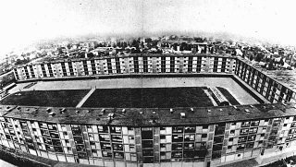
March 27, 1942: Germans begin the deportation of more than 65,000 Jews from Drancy to the east
This multistory complex served as the Drancy transit camp. The overwhelming majority of Jews deported from France were held here prior to their deportation. Drancy, France, 1941-1944.
The Drancy camp was established by the Germans in August 1941 as an internment camp for foreign Jews in France; it later became the major transit camp for the deportations of Jews from France.
http://www.ushmm.org/wlc/en/article.php?ModuleId=10005215

Slide 20
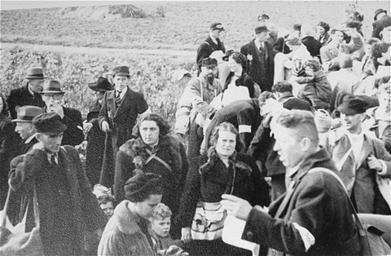
July 15,1942: Systematic deportations from the Netherlands begin
Arrival of Jews at the Westerbork transit camp. The Netherlands, 1942.
Jews in the Netherlands have been concentrated in the Westerbork transit camp before their deportation to killing centers in the east. Beginning on July 15, 1942, the Germans deport nearly 100,000 Jews from Westerbork and the overwhelming majority of those deported are killed upon arrival in the camps.
http://www.ushmm.org/wlc/en/article.php?ModuleId=10005436

Slide 21
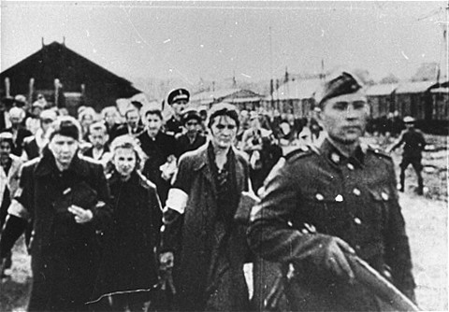
July 22, 1942: Germans begin the mass deportation of over 300,000 Jews from the Warsaw ghetto to the Treblinka killing center.
Jews under guard during deportation from Warsaw. Warsaw, Poland, July-September 1942.
From July 22 until September 12, 1942, German SS and police units, assisted by auxiliaries, carried out mass deportations from the Warsaw ghetto to Treblinka. During this period, the Germans deported about 265,000 Jews from Warsaw; they killed approximately 35,000 Jews inside the ghetto during the operation. By September 12, 1942, Germans complete the mass deportation of about 265,000 Jews from Warsaw to Treblinka.
http://www.ushmm.org/wlc/en/article.php?ModuleId=10005069

Slide 22
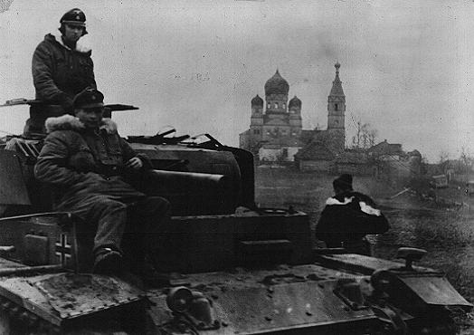
November, 1942: The Soviet army launched a massive counteroffensive against the German Sixth Army
German soldiers in the Soviet Union during a December 1943 Soviet offensive on the eastern front. German troops invaded Soviet territory in June 1941 but faced counteroffensives following the battle of Stalingrad. December 16, 1943.
The Soviet troops encircled and trapped the German forces. Following six more weeks of fierce combat in which both sides took heavy casualties, some 91,000 surviving German soldiers surrendered between January 31 and February 2, 1943.
http://www.ushmm.org/wlc/en/article.php?ModuleId=10005507

Slide 23
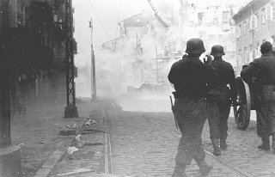
April 19, 1943: Warsaw ghetto uprising begins
German soldiers direct artillery against a pocket of resistance during the Warsaw ghetto uprising. Warsaw, Poland, April 19-May 16, 1943.
The German forces intended to begin the operation to liquidate the Warsaw ghetto on April 19, 1943, the eve of Passover. When SS and police units entered the ghetto that morning, the streets were deserted. Nearly all of the residents of the ghetto had gone into hiding places or bunkers. The renewal of deportations was the signal for an armed uprising within the ghetto.
http://www.ushmm.org/wlc/en/article.php?ModuleId=10005188

Slide 24
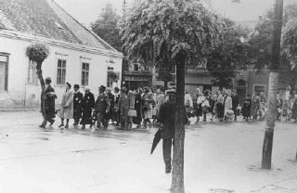
March 19, 1944: Germans forces occupy Hungary
May 15, 1944: Germans begin the mass deportation of about 440,000 Jews from Hungary
Deportation of Hungarian Jews. Koszeg, Hungary, May 1944.
After the German defeat at Stalingrad on the eastern front in 1942-1943, Prime Minister Miklos Kallay sought to negotiate a separate armistice for Hungary with the western Allies. In order to forestall these efforts, German forces occupied Hungary on March 19, 1944. The Hungarian authorities began to systematically deport the Hungarian Jews. In less than two months, nearly 440,000 Jews were deported from Hungary and most were deported to Auschwitz. By the end of July 1944, the only Jewish community left in Hungary was that of Budapest, the capital.
http://www.ushmm.org/wlc/en/article.php?ModuleId=10005458

Slide 25
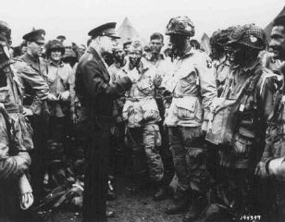
June 6, 1944: D-Day: Allied forces invade Normandy, France
General Dwight D. Eisenhower visits with paratroopers of the 101st Airborne Division just hours before their jump into German-occupied France. June 5, 1944.
On June 6, 1944, under overall command of General Dwight D. Eisenhower and, on the ground, of British General Bernard Montgomery, more than 130,000 Allied troops landed on five beaches, code named Omaha, Gold, Juno, Sword, and Utah. The night before, 23,000 paratroopers landed in France behind the German defensive lines. The invasion force of more than 155,000 troops included 50,000 vehicles (including 1,000 tanks). Nearly 7,000 naval craft and more than 11,500 aircraft supported the invasion.
http://www.ushmm.org/wlc/en/article.php?ModuleId=10005158

Slide 26
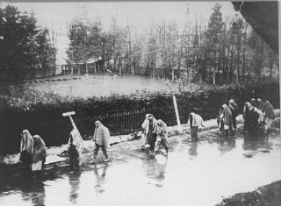
January 18, 1945: Death march of nearly 60,000 prisoners from the Auschwitz camp system in southern Poland
A view of the death march from Dachau passing through villages. German civilians secretly photographed several death marches from the Dachau concentration camp. Few civilians gave aid to the prisoners on the death marches. Germany, April 1945.
A massive Soviet 1944 summer offensive in eastern Belarus annihilated German Army Group Center and permitted Soviet forces to overrun the first of the major Nazi concentration camps, Lublin/Majdanek. Shortly after that offensive, SS chief (Reichsfuehrer SS) Heinrich Himmler ordered that prisoners in all concentration camps and subcamps be evacuated toward the interior of the Reich. Death marches from Buchenwald and Dachau would begin in April.
http://www.ushmm.org/wlc/en/article.php?ModuleId=10005162

Slide 27
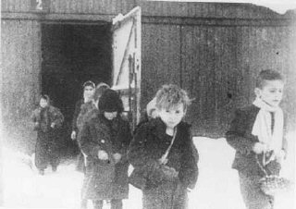
January 27, 1945: Soviet troops liberate the Auschwitz camp complex. April 29, 1945: American forces liberate the Dachau concentration camp
Soon after liberation, surviving children of the Auschwitz camp walk out of the children's barracks. Poland, after January 27, 1945.
The Soviet army entered Auschwitz, Birkenau, and Monowitz and liberated around 7,000 prisoners, most of whom were ill and dying. American forces liberated Dachau in April. As they neared the camp, they found more than 30 railroad cars filled with bodies brought to Dachau, all in an advanced state of decomposition. In early May 1945, American forces liberated the prisoners who had been sent on the death march.
http://www.ushmm.org/wlc/en/article.php?ModuleId=10005189

Slide 28
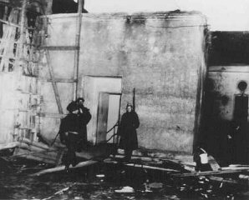
April 16-30, 1945: The Soviets launch their final offensive, encircling Berlin. Adolf Hitler commits suicide
Soviet soldiers guard the entrance to Hitler's underground bunker. Upon the advance of Soviet forces through the streets of Berlin, Hitler committed suicide here on April 30, 1945, rather than face capture. Berlin, Germany, 1945.
The Soviets began an offensive on January 12, liberating western Poland and forcing Hungary to surrender. In mid-February 1945, the Allies bombed the German city of Dresden, killing approximately 35,000 civilians. American troops crossed the Rhine River on March 7, 1945. A final Soviet offensive on April 16, 1945, enabled Soviet forces to encircle the German capital, Berlin.
http://www.ushmm.org/wlc/en/article.php?ModuleId=10005137

Slide 29
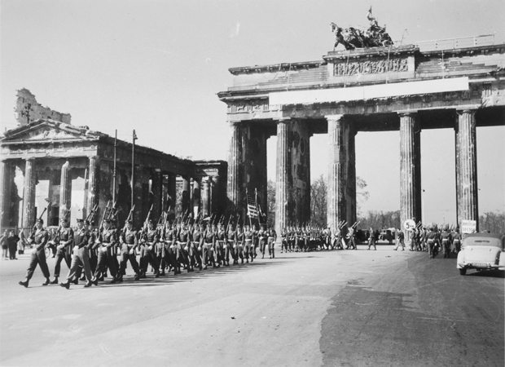
May 7-9, 1945: Germany surrenders to the western Allies and surrenders to the Soviets
U.S. Army troops march through the Brandenburg Gate in Berlin.
From their bridgehead across the Oder River, Soviet forces launched a massive final offensive toward Berlin in mid-April 1945. The German capital was encircled on April 25. Soviet forces linked up with their American counterparts attacking from the west at Torgau, on the Elbe River in central Germany. On May 7, Germany surrendered unconditionally to the Western Allies at Reims and on May 9 to the Soviets in Berlin.
http://www.ushmm.org/wlc/en/article.php?ModuleId=10005186

Slide 30
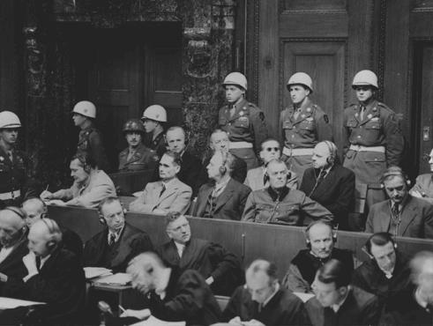
1945-1946: Nuremberg War Trials
The defendants listen as the prosecution begins introducing documents at the International Military Tribunal trial of war criminals at Nuremberg. November 22, 1945.
After the war, some of those responsible for crimes committed during the Holocaust were brought to trial. Nuremberg, Germany, was chosen as a site for the trials. Judges from the Allied powers -- Great Britain, France, the Soviet Union, and the United States -- presided over the hearings of twenty-two major Nazi criminals. Twelve prominent Nazis were sentenced to death.
http://www.ushmm.org/outreach/en/article.php?ModuleId=10007722

