Slide 1
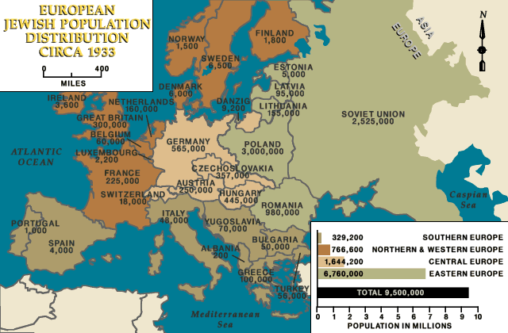

Slide 2
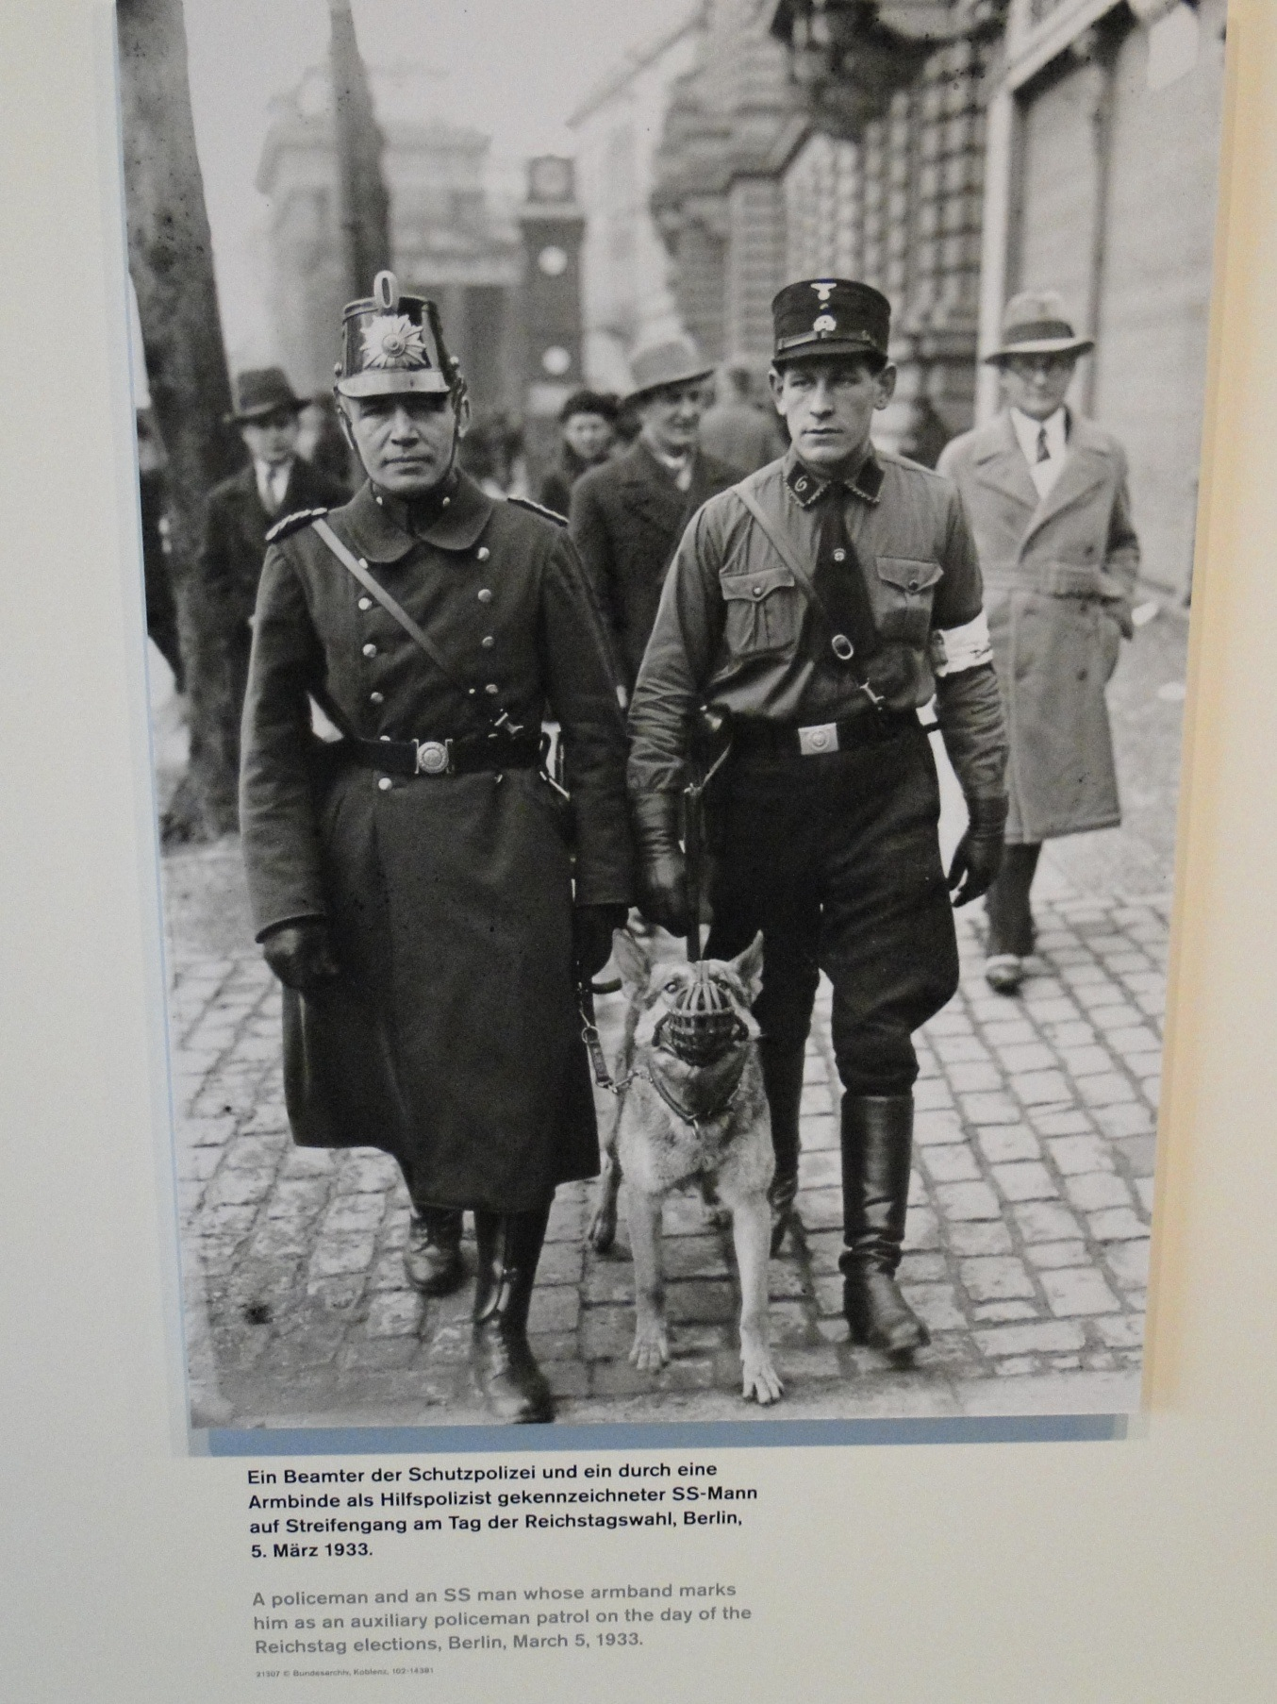
Nazis utilized terror and legal measures to obtain a one-party dictatorship from a democracy

Slide 3
Nazi Policy of Inclusion and Exclusion
Cornerstone of Nazi ideology and propaganda was that of the Volksgemeinschaft, or “national community” - a racial union of all “Aryan” Germans that would transcend class, religious and regional differences. Individual rights were deemphasized in favor of stressing sacrifice for the good of the “national community”.
To accomplish the goals of the “national community,” the Nazis emphasized the policy Gleischaltung, the coordinating of all society around Nazi values. “Working towards the Fuehrer.”
Consequently, all those NOT in the national community must be excluded or removed for the health of the community.

Slide 4
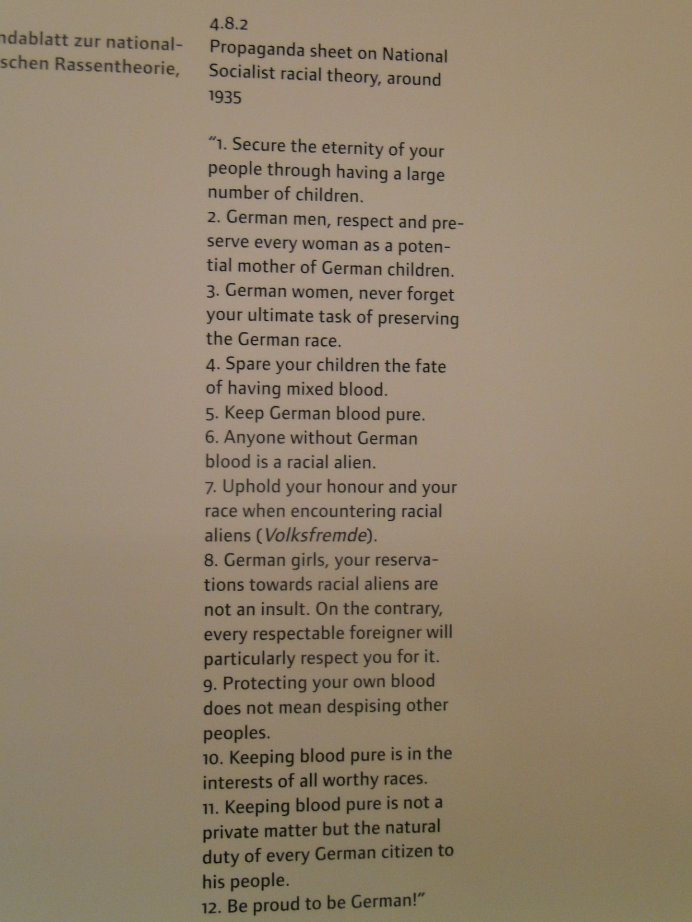

Slide 5
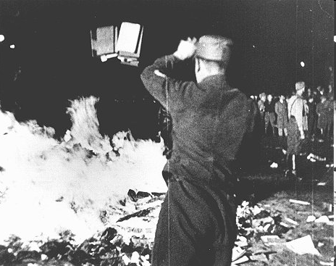
1933: Nazi Book Burning

Slide 6
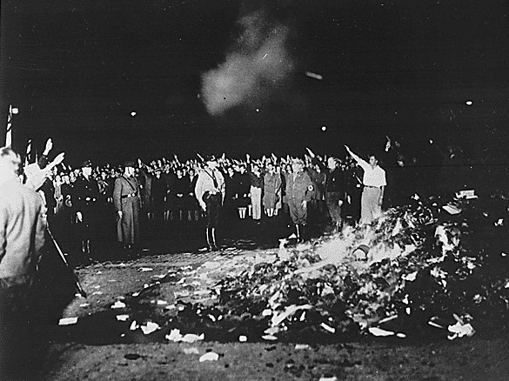
“Where books are burned, in the end people will be burned” Heinrich Heine 1821

Slide 7
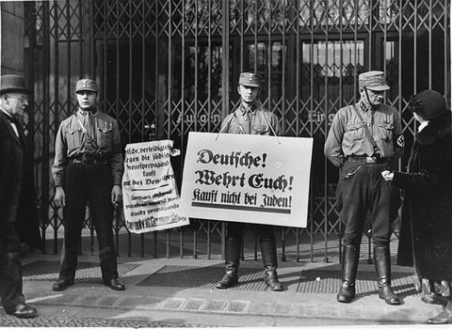
1933 and 1936: Nazi Boycott of Jewish businesses

Slide 8
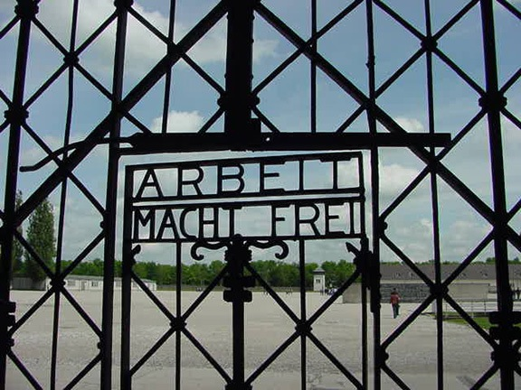
1933: Dachau concentration camp created for political opponents of Nazis

Slide 9
Nazi anti-Semitic Propaganda
Propaganda is biased info designed to shape public beliefs and behavior
Uses truths, ½ truths, lies, omits info selectively, simplifies complex issues or ideas, plays on emotions, attacks opponents, targets desired audience.
Seeks assent, not reasoned argument
Coupled with power of the state- state has power to protect or punish those who agree or disagree with its policies

Slide 10
One crucial factor in creating a cohesive group is to define who is excluded from membership. Nazi propagandists contributed to the regime's policies by publicly identifying groups for exclusion, justifying their outsider status, and inciting hatred or cultivating indifference.
Nazi propaganda was crucial in selling the myth of the "national community" to Germans who longed for unity, national pride and greatness, and a break with the rigid social stratification of the past. But a second, more sinister aspect of the Nazi myth was that not all Germans were welcome in the new community.
Propaganda helped to define who would be excluded from the new society and justified measures against the "outsiders."

Slide 11
Nazi anti-Semitic Propaganda
Nazis plan to immediately implement anti-Semitic policy so there is the need to make the public either embrace these measures or make them amenable to accept them.
Jews defined as a threat to the health and security of the Volksgemeinshaft- the German “national community.”
Inundate society with anti-Semitic propaganda- create climate of indifference to their plight.
Most Germans don’t know any Jews so create image of sinister, dangerous Jew.

Slide 12
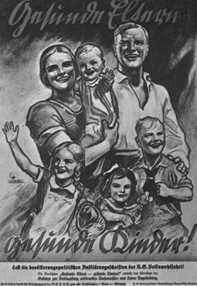
A Nazi propaganda poster encourages healthy Germans to raise a large family. The caption, in German, reads: "Healthy Parents have Healthy Children." Germany, date uncertain.

Slide 13
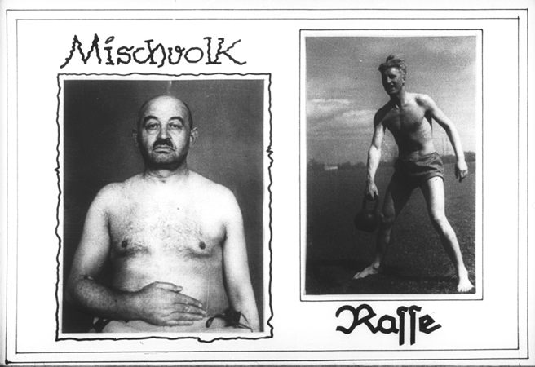
Propaganda slide which contrasts a person of mixed race (at the left) with a healthy "Aryan" youth (at the right).

Slide 14
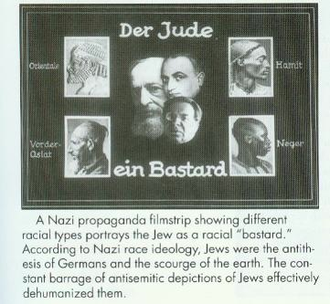

Slide 15
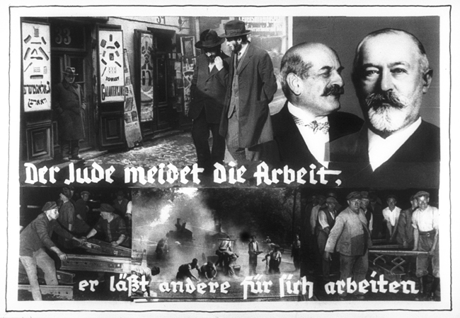
Propaganda slide entitled "The Jew avoids work, he lets others do the work for him," that juxtaposes pictures of Jews walking idly through a Jewish quarter and Germans at hard, physical labor.

Slide 16
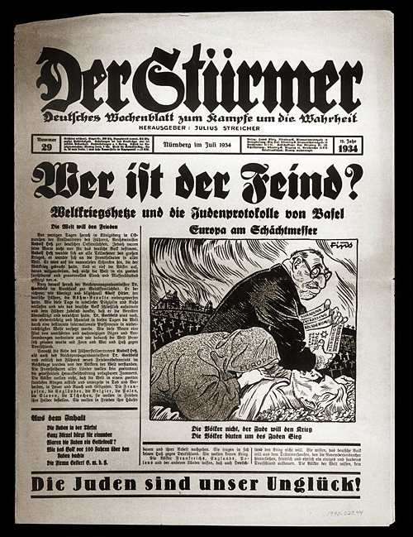
“Who is the enemy?” “The Jews are our misfortune!”

Slide 17
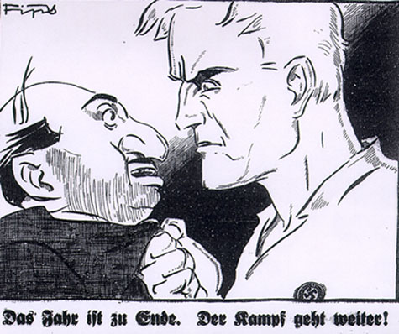
“The struggle goes on.”

Slide 18
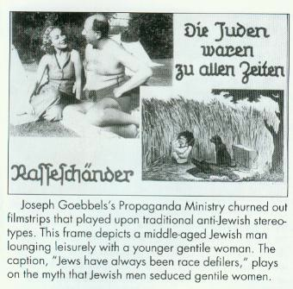

Slide 19
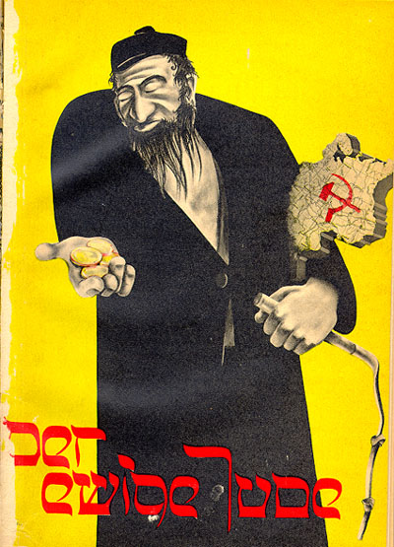
Nazi propaganda film: “The Eternal Jew” What stereotypes do you see in this image?

Slide 20
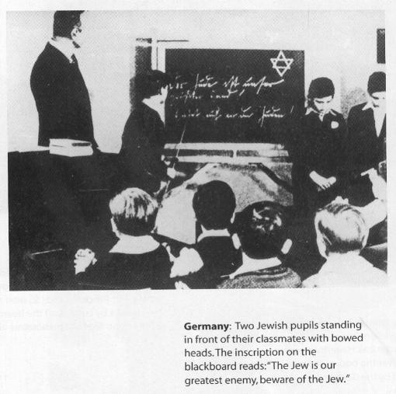

Slide 21
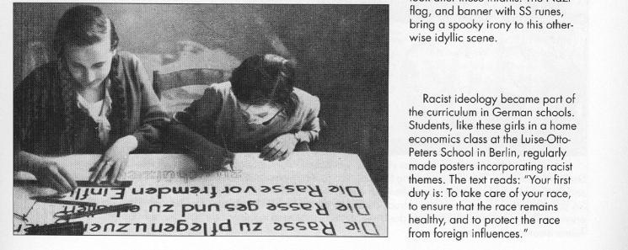

Slide 22
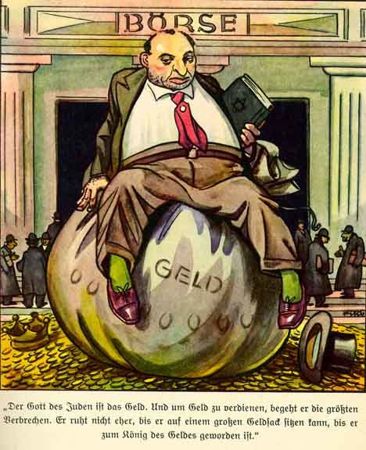
"The God of the Jews is money. To earn money, he commits the greatest crimes. He will not rest until he can sit on a huge money sack, until he has become the king of money."*

Slide 23
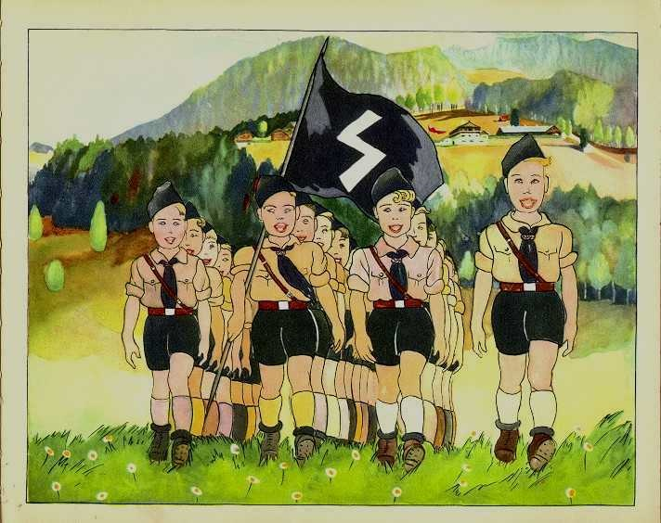
The Führer’s Youth
The boys who are true Germans To Hitler’s Youth belong. They want to live for their Führer, Their eyes are fixed on the future. Bigger and stronger they have become. The German Heritage is theirs. The great and sacred Fatherland Stands today as it ever stood. From this picture may be seen, Hitler Youth in splendid mien, From smallest to the biggest boy. All are husky, tough, and strong. They love their German Führer And God in Heaven they fear.
But the Jews they must despise! They’re not like these boys, So Jews must just give way!

Slide 24
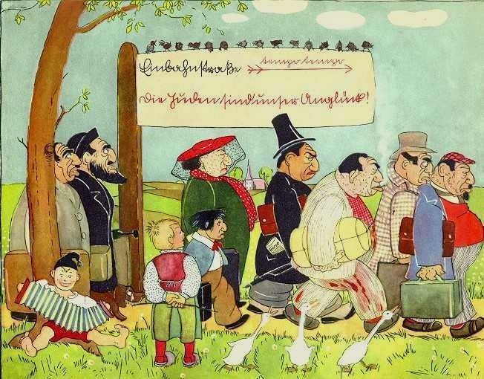
(On the signpost: “One-way road. Hurry, Hurry. The Jews are our misfortune.”)

Slide 25
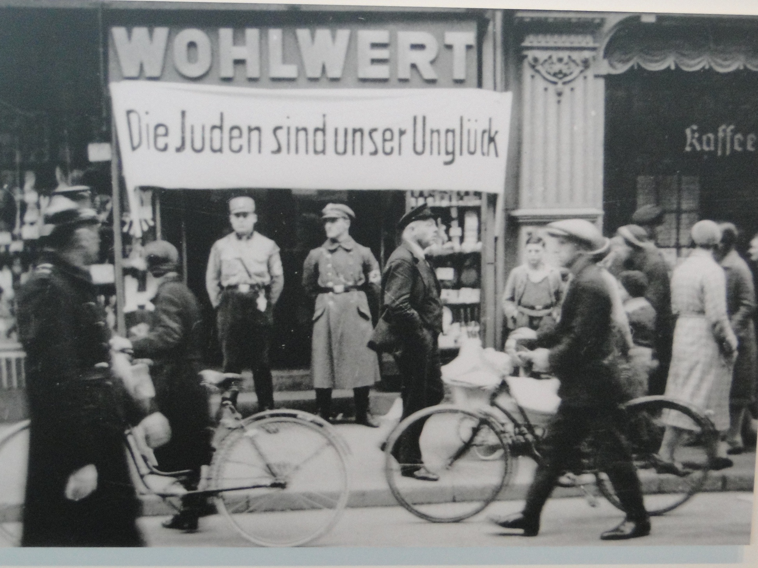
“The Jews Are Our Misfortune”

Slide 27
1935 Nuremburg Laws
Series of laws passed that officially excluded Jews from German citizenship
Specifically defined who is a Jew and who is a German
Jews systematically excluded from public life in Germany

Slide 28
Laws on Citizenship and Race
Only those with “German blood” are citizens
Jews excluded from German citizenship- systematically excluded from German life
Defined criteria for Germans, Jews and those of “mixed blood”

Slide 29
“Laws for the Protection of German Blood and German Honor”
Marriage Between Jews and Germans prohibited- as are physical relations
Jews may not employ female Germans in their households
Jews may not hoist German flag

Slide 30
"The Law for the Protection of the Genetic Health of the German People"
Nazi concerned with “Racial Hygiene”- must preserve those with pure Aryan blood
Those wanting to marry must get medical exam
Full Jew= 3 Jewish grandparents
Mischlinge= 1st and 2nd degree based on Jewish blood mixed with German

Slide 31
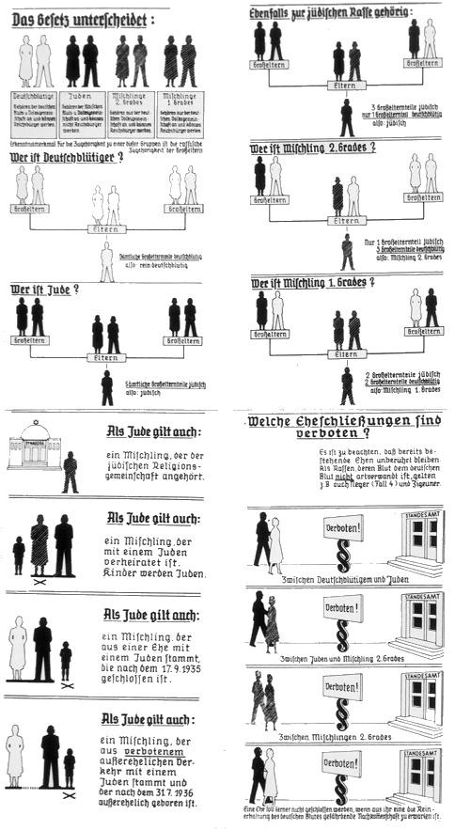

Slide 32
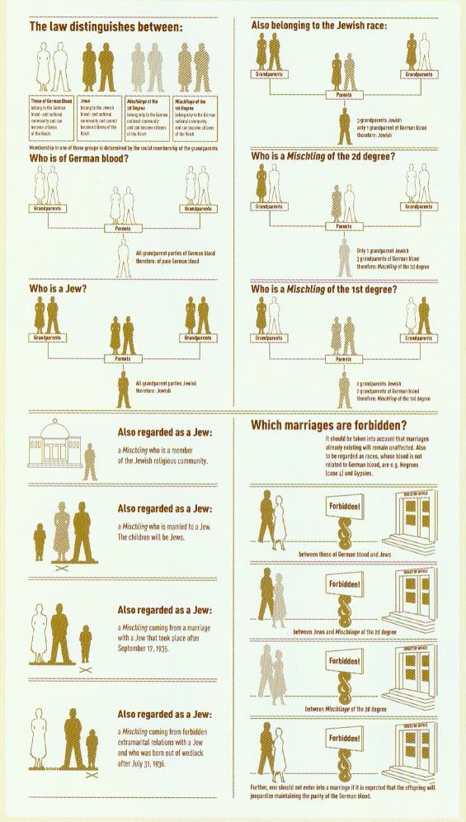

Slide 33
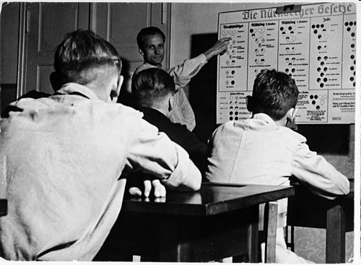
A teacher explains racial definitions according to the Nuremberg Laws

Slide 34
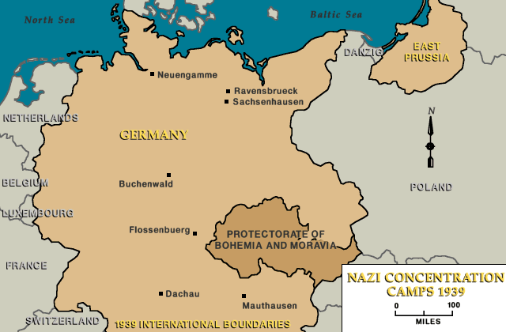

Slide 35
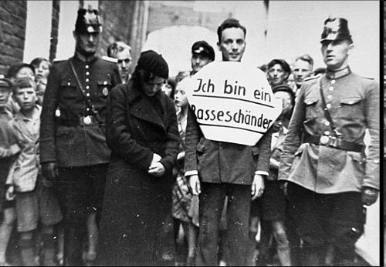
In this photograph, a young man who allegedly had illicit relations with a Jewish woman is marched through the streets for public humiliation. Flanked by German police officers, he wears a sign that reads, "I am a defiler of the race." Norden, Germany, July 1935.
Notes:
In this photograph, a young man who allegedly had illicit relations with a Jewish woman is marched through the streets for public humiliation. Flanked by German police officers, he wears a sign that reads, "I am a defiler of the race." These events were calculated to both punish the so-called offenders and to make a public example of them as a deterrent to others who might not fully subscribe to Nazi racial theory. Norden, Germany, July 1935.

Slide 36
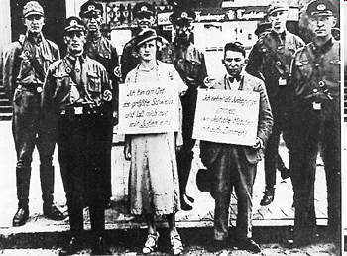
"I am the greatest pig in town - I have affairs with Jews only." This scene, organized for the press in Hamburg in 1935, appeared in all German newspapers. The man's sign says: "I only take German girls to my room." The Nuremberg laws of 1935 criminalized sexual relations between Jews and "Aryans."

Slide 37
Retirement
From 1933 until the outbreak of war in 1939, Jews felt the effects of more than 400 decrees and regulations that restricted all aspects of their public and private lives.
All “non-Aryan” civil servants fired from their positions
Jewish teachers and students excluded from schools and universities
Excluded from legal and medical professions
Open jobs for “Aryans”

Slide 38
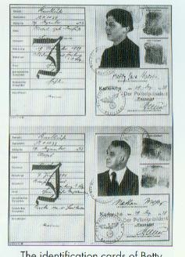
August 17, 1938 Executive Order on the Law on the Alteration of Family and Personal Names requires Jews to adopt an additional name: "Sara” for women and “Israel” for men.

Slide 39
1938 the November Pogrom: Kristallnacht: Night of Broken Glass
Nazi orchestrated wave of violence against Jewish businesses- 7,500 looted and destroyed
91 Jews killed in street violence
267 synagogues burned and vandalized
25,000 Jewish men rounded up and sent to concentration camps
Jews themselves fined 1 billion marks for the destruction

Slide 40
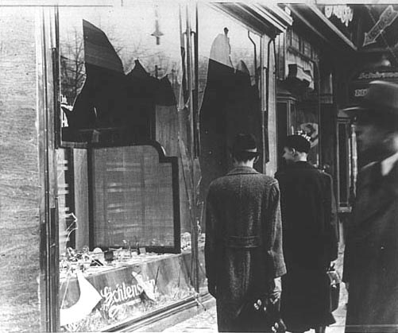
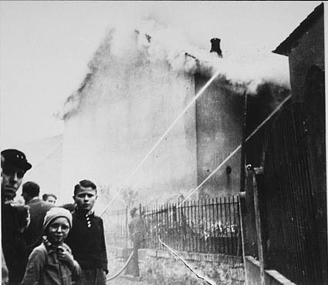
Kristallnacht: Night of Broken Glass

Slide 41
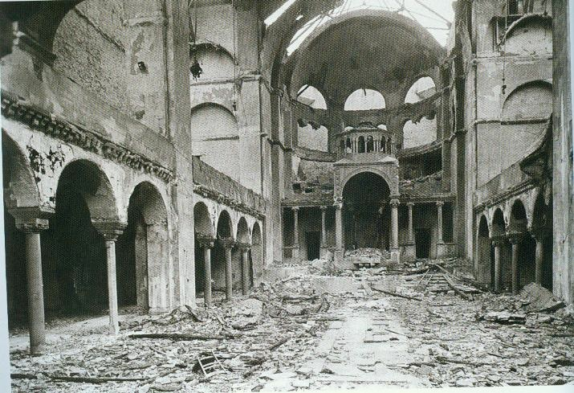

Slide 42
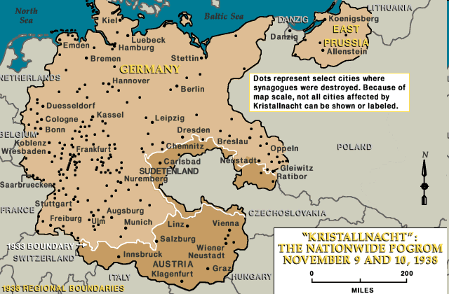

Slide 43
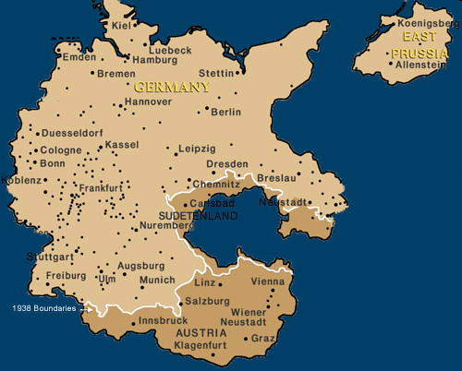
Synagogues Destroyed on Kristallnacht

Slide 44
Kristallnacht as a Turning Point in the Holocaust
Previously, the Nazis employed mostly legal measures against Jews- this was the first major act of flagrant state-sponsored violence and a departure from previous policy.
It was at this point that many Jews in Germany realized that they had to try to leave- there was no safety or security for their families. Emigration greatly increased after Kristallnacht.

Slide 45
Kristallnacht as a Turning Point in the Holocaust
Many see this event as the start of the Holocaust
Jews are blamed for Kristallnacht and fined $I billion Reichmarks to pay for cleanup and government services like police and firemen
Laws and restrictions against Jews become more and more repressive and unbearable

Slide 46
Kristallnacht as a Turning Point in the Holocaust
The Nuremberg Laws, concentration camps and doctrine of Lebensraum are in place, yet it becomes clear that forced immigration of Jews out of the Reich is not a feasible option.
The Nazis realize they need a more “permanent solution” to the Jewish question- a “Final Solution.”
The passivity of the German people and virtually no real action from foreign nations send the message that they could expect little to no opposition in further measures against Jews

Slide 47
After Kristallnacht
Series of increasing restrictions and prohibitions against Jews in Third Reich- life will become more and more intolerable
Jews can no longer own businesses- must sell their businesses
Jews forbidden to attend plays or concerts
Jewish children removed from schools- must attend all Jewish schools
Curfews are enforced for Jews

Slide 48
Emigration
Order to speed up Jewish emigration
Jews attempting to leave Germany must pay exorbitant amount of money
Become poor refugees- world wide economic depression- many countries won’t take them
By 1939, half of Germany’s 500,000 Jews had emigrated to escape Nazi persecution.

