Slide 1

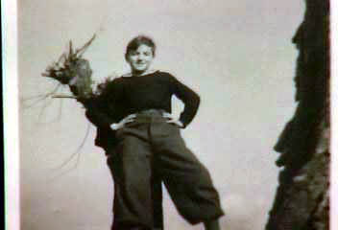
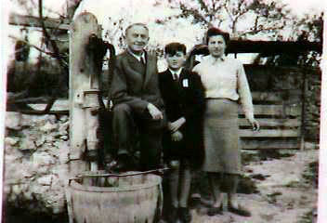
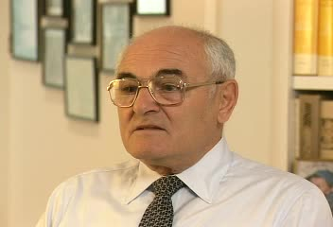
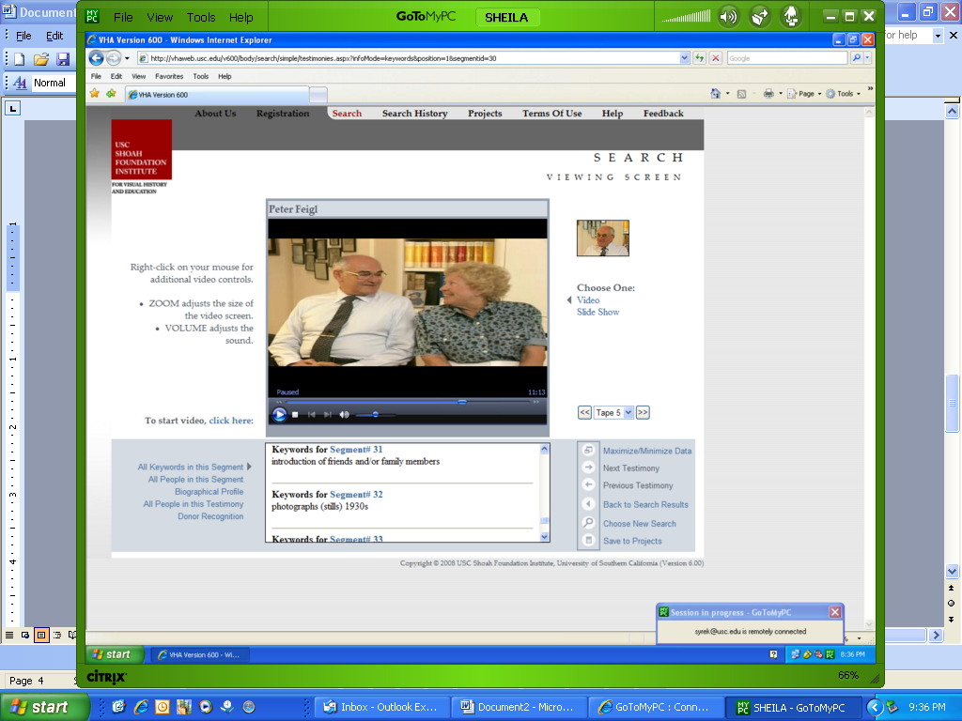

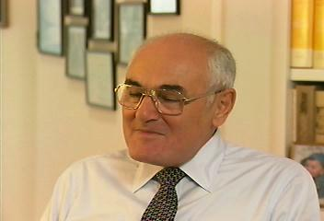
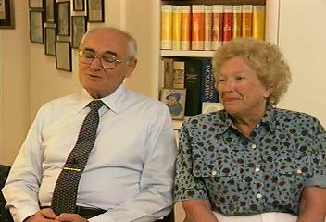
One Man, Two Voices:
Peter Feigl’s Diary and Testimony
(Sunday, November 15, 2009, Draft —Demo Copy — Not for Distribution)

Slide 2
Introduction: Primary Sources
View
Primary Source
Analysis I Activity
View Clip 1:
Introduction
View
Primary Source
Analysis II Activity
View
Primary Source
Comparison Activity
Diary Image ©United States Holocaust Memorial Museum, Peter Feigl Collection
2

Slide 3
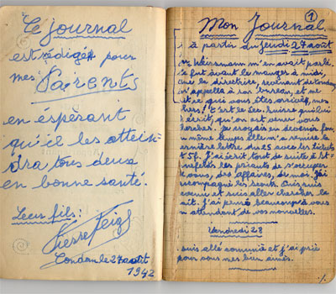
Introduction: Diary Context
View
Map of Peter’s Journey through France
View Clip 2:
Summer Camp
View Activity 1
“This diary is written for my parents in the hope that it will reach them both in good health. Their son: Pierre FEIGL. Condom, August 27, 1942.”
View Clip 3:
Father’s Handkerchief
View Clip 4:
Handkerchief’s Significance
View Clip 5:
Diaries
Diary Image ©United States Holocaust Memorial Museum, Peter Feigl Collection
Diary text reprinted with permission from Salvaged Pages, Alexandra Zapruder, Yale University Press, 2002
3

Slide 4
Poster Set
OWL Poster Guide
Option 1
OWL Poster Guide
Option 2
4

Slide 5
Poster 1
My Diary as of Thursday, August 27, 1942
“…It was before lunch that the [summer camp]
directress, returning from Condom, called me to
her office and told me what had happened to you,
my dearest!
It was the Sec. Suisse which wrote her that they
had come for you. I thought I would go mad.”
1. What Do You Observe?
2. What Do You Wonder?
View
Original Swiss Red Cross Letter
View
Translated Swiss Red Cross Letter
Tuesday, September 1, 1942
“The start of a new month. I wait to hear from
you. Nothing for me. At noon, Mrs. C. orders me to
bed and tells me that they (3 gen.) want to pick me
up. She has a cert. At two o’clock, they come.
But thanks to the cert. they leave me.”
View Clip 6:
Eluding Arrest
View Translated Oral History Transcript
3. What Did You Learn?
Reprinted with permission from p. 69, Salvaged Pages, Alexandra Zapruder, Yale University Press, 2002
5

Slide 6
Poster 2
Sunday, September 6, 1942
“Nothing. I am in bed.”
1. What Do You Observe?
Monday, September 7, 1942
“Nothing from you. Still in bed…”
2. What Do You Wonder?
View Clip 7:
Parents’ Fate
Tuesday, September 8, 1942
“I am in bed. Nothing from you. I often think of you.”
Thursday, September 10, 1942
“Nothing from you…”
View Convoy 28
Friday, September 11, 1942
“Still nothing. I wait.”
3. What Did You Learn?
Reprinted with permission from p. 70, Salvaged Pages, Alexandra Zapruder, Yale University Press, 2002
6

Slide 7
Poster 3
Wednesday, October 7, 1942
“I filled out the forms for America. A ship leaves on
November 25. It’s the one I am to take…. What a
joy this will be for you and for me, too. You’ll know
that I am safe. And you?”
1. What Do You Observe?
2. What Do You Wonder?
View
Original French Emigration Request
View
Translated French Emigration Request
Friday, October 9, 1942
“Mrs. Cavailhon has just gotten permission from the
Ministry of Interior and from the préfecture for me
to remain under the protection of the Quakers and
that I am allowed to go out while waiting to leave for
the United States. It’s certain now. Yet I can’t
bring myself to believe it.”
View Original Deputy Prefect’s Request
View Translated Deputy Prefect’s Request
View
Original Prefect’s Response
View Translated Prefect’s Response
3. What Did You Learn?
Reprinted with permission from p. 72, Salvaged Pages, Alexandra Zapruder, Yale University Press, 2002
7

Slide 8
Poster 4
Friday, October 23, 1942
“The emigration forms were returned from Marseilles to Mrs. Cavailhon saying … as far as the young Feigl is concerned, if he is Catholic, it is not certain whether
he’ll be able to go.”
1. What Do You Observe?
2. What Do You Wonder?
View Clip 8:
Baptism
Saturday, October 24, 1942
“The gendarmes came again. They asked if I was still at the home.”
View Clip 9:
Children’s Transport
Wednesday, November 11, 1942
“The English and Am. attacked North Africa. We were
able to read the leaflets. They were everywhere. The gendarmes came to collect them.”
View Original Letter to Quakers
View Translated Letter to Quakers
View Clip 10: Fate of Children’s Transport
Tuesday, November 24, 1942
“Tomorrow is the day when the ship was to sail. Good-bye ship.”
3. What Did You Learn?
Reprinted with permission from p. 73-76, Salvaged Pages, Alexandra Zapruder, Yale University Press, 2002
8

Slide 9
Poster 5
Thursday, November 5, 1942 [Marseilles]
“…So after a one-hour hike in darkness, we arrived at a colony (Les Caillols) where it was decided to keep me.”
1. What Do You Observe?
2. What Do You Wonder?
Sunday, December 27, 1942 [La Rouvière]
“Mr. Brémond sent me to La Rouvière because I talked
to the Germans. I cried a lot but he promised me that I
would be allowed to return to Les Caillols.”
View
Les Caillols Group
View
Peter at Les Caillols
Monday, January 4, 1943
“Mr. Br. came to La Rouvière today. I practically flooded
him with tears. Then he told me to pack my things within
five minutes because he is taking me along. I can tell
you that I was happy.”
View Clip 11:
Waffen SS
3. What Did You Learn?
Reprinted with permission from pp. 74, 76-77, Salvaged Pages, Alexandra Zapruder, Yale University Press, 2002
9
Notes:
PF: By late June, France collapsed, signed an armistice with Germany, and at the end of June, or early July, my mother, as barracks chief, learned that there would be a German Wehrmacht, a German Army inspection team coming the next day to inspect the camp. At this point, my mother, partly out of desperation, decided that since her passport did not bear a “J” she would see if she couldn’t bluff her way out of this camp. So the next morning she managed to maneuver herself right to the entrance of the camp, and she had me by the hand, and when the German army delegation appeared, she pushed herself forward and brandishing her passport, her German passport, she yelled, “Heil Hitler, Oberst” (Heil, Hilter, Colonel). “I am a German national and I demand to be released instantly from this filthy French camp where we have been detained: my mother and my child, and I want to get out right away!” And he was taken aback, looked at her passport, and turned to the French camp commander, and said to him in broken French, “You let madame out immediately. And you call taxi. And you pay for the taxi to take madame and her mother and her child wherever they want to go!” And within a half hour or forty minutes, we were in a cab and the cab driver said, “Where to?” And my mother said, “North” because she knew that we couldn’t go into Spain because the Spaniards were guarding the frontier and keeping people from coming across. After several hours on the road we arrived in a town, outside of a town called Auch, A-U-C-H, in the Department of Gers, G-E-R-S. And there refugees came across the railroad tracks from the north towards us and they waved the cab driver off and said, “Don’t go any further north, there are German troops on the other side of town.”

Slide 10
Poster 6
Friday, January 15, 1943
“We were told that we’ll have to get out in two or three days… Mrs. B. told me that she received a telegram
from Mr. Trocmé. He has a vacancy and expects me
as soon as possible. Once again I am in luck.”
Saturday, January 16, 1943 [Le Chambon Sur
Lignon]
…Mr. Trocmé came on his bicycle to meet me…. Now
we still had to cover fifteen kilometers through the snow and a moonlit night. We arrived at Les Grillons at 2:30 A.M. ..”
1. What Do You Observe?
2. What Do You Wonder?
View Clip 12:
Arrival at Le Chambon
View Les Grillons, 1943
View Peter in School, 1943
Sunday, January 17, 1943
“…There are children here in various situations (some
like me).”
Tuesday, January 19, 1943
“Today I went to school for the first time. Every day we
have to cover twelve kilometers in the snow…”
View Daniel Trocmé
View Clip 13:
People of Le Chambon
3. What Did You Learn?
Reprinted with permission from pp. 77-78, Salvaged Pages, Alexandra Zapruder, Yale University Press, 2002
10

Slide 11
Poster 7
Monday, February 1, 1943
1. What Do You Observe?
January 1, 2, and 3, 1944: [Collège Champillon,
Figeac]
“Was a little bored. Left at two o’clock and arrived at Collège on Tuesday, January 4, in the evening.”
2. What Do You Wonder?
View Diary 1
Wednesday, March 1, 1944:
“I couldn’t drag myself out of bed this morning. I went
to class. ..The weather is beautiful and the snow has
melted. That’s practically my only consolation…”
View Clip 14:
Collège Champillon in Figeac
Friday, March 17, 1944
“…this afternoon Germans came to look over the
Collège. It seems they want to use it as a hospital.”
3. What Did You Learn?
Reprinted with permission from pp. 79, 84-85, Salvaged Pages, Alexandra Zapruder, Yale University Press, 2002
11

Slide 12
Poster 8
Sunday, May 7, 1944
“…This morning I was told that I must leave tomorrow morning at eight o’clock…I threw away all my note-
books. After dinner, all is ready. That’s when I’m told that I don’t have to leave. Damn!!!”
1. What Do You Observe?
Thursday, May 11, 1944
“This morning the Germans came through riding on
tanks et cetera… In town and in the surrounding area things are hopping and are really getting hot…I hope
I’ll be able to leave soon because I have had it…”
2. What Do You Wonder?
View Clip 15: Reoccupation of Figeac
Friday, May 12, 1944
“…There are Krauts and armored vehicles everywhere.
All the males between the age of sixteen and fifty-four
must report to the gendarmerie…The Germans
came searching…”
Wednesday, May 17, 1944
“At eight o’clock, at the very moment I was to leave, Wham! I won’t leave until tomorrow. There is no train…”
3. What Did You Learn?
Reprinted with permission from pp. 86-87, Salvaged Pages, Alexandra Zapruder, Yale University Press, 2002
12

Slide 13
Poster 9
Monday, May 22, 1944 [Geneva]
“The column starts walking behind the passeurs…”
1. What Do You Observe?
2. What Do You Wonder?
“…He makes us lie flat on the ground. It rained and
it’s not pleasant. My feet are soaking wet…”
View
May 22, 1944 Diary Entry
View Map
“…On the run we get nearer to the barbed wires.
We throw our backpacks over the fence and we cross wherever feasible. A Swiss guard is watching us. We cross at Sorral II. We are well received…”
View Clip 16:
Escape
View
Original Swiss Interrogation
Report
View
Translated
Swiss Interrogation
Report
“…There the interrogations start. We eat well. At 11
P.M. I take a shower and they inspect our scalp.
Then I sleep soundly in a free country.”
3. What Did You Learn?
Reprinted with permission from p. 88, Salvaged Pages, Alexandra Zapruder, Yale University Press, 2002
13

Slide 14
Poster 10
1. What Do You Observe?
From Thursday, May 25, to Tuesday, May 30, 1944
“Nothing special, camp life, we eat well. I wrote to Mr. Gersonde…”
2. What Do You Wonder?
View Activity 2
Monday, June 6, 1944
“Letter from Mr. Gersonde. Very happy…”
View Clip 17:
The Gersonde Family
Tuesday, June 7, 1944
“Wrote Mr. Gersonde with two photos.”
View Clip 18: Response to Freedom
“Arrived Bern June 26, 1944, 1:30 P.M.”
3. What Did You Learn?
Reprinted with permission from pp. 88-89, Salvaged Pages, Alexandra Zapruder, Yale University Press, 2002
14

Slide 15
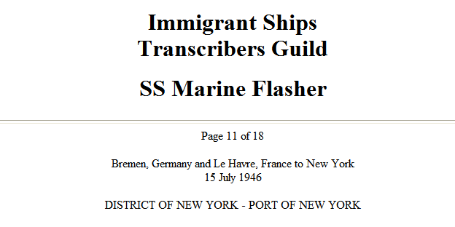
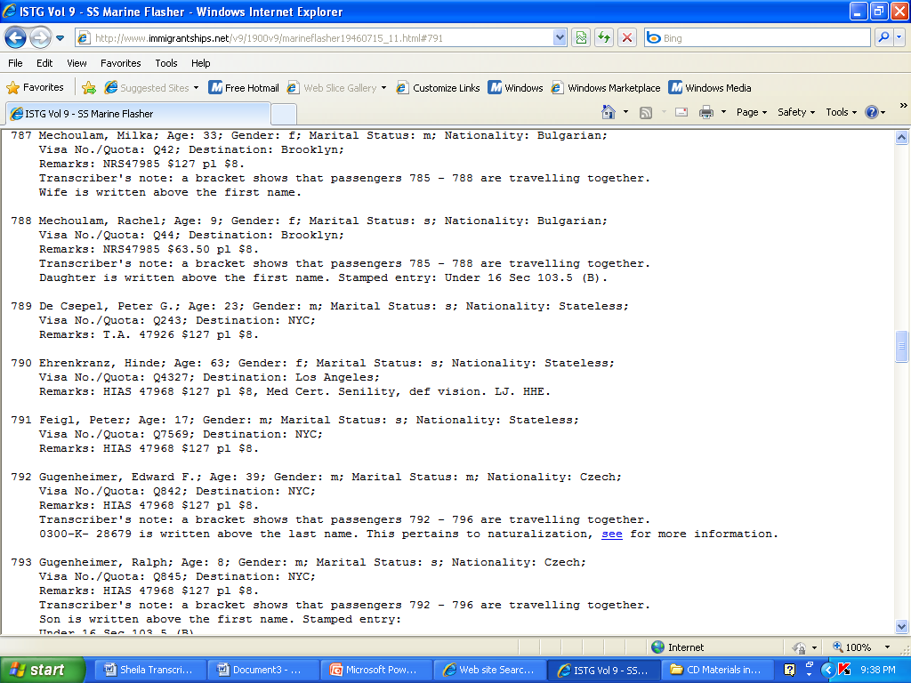
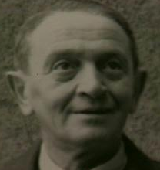
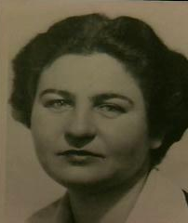
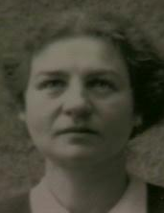
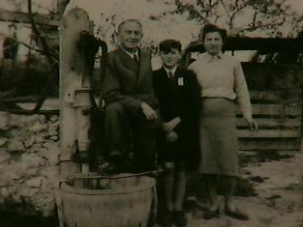
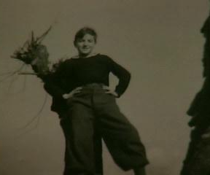
Conclusion
View Clip 19: Departure
View Original Quakers’ Letter to OSE
View Translated Quakers’ Letter to OSE
First they came for the Socialists, and I did not speak out because I was not a Socialist. Then they came for the Trade Unionists, and I did not speak out because I was not a Trade Unionist. Then they came for the Jews, and I did not speak out because I was not a Jew. Then they came for me, and there was no one left to speak for me. --Pastor Martin Niemöller
View Clip 20: Message to the Future
View Clip 21:
Still Photos
View
Biography of Peter Feigl
15

Slide 16
Additional Resources
Related Articles:
“France,” Holocaust Encyclopedia, United States Holocaust Memorial Museum, http://www.ushmm.org/wlc/article.php?lang=en&ModuleId=10005429
“Quakers,” Holocaust Encyclopedia, United States Holocaust Memorial Museum,” http://www.ushmm.org/wlc/article.php?lang=en&ModuleId=10005212
“Drancy,” Holocaust Encyclopedia, United States Holocaust Memorial Museum, http://www.ushmm.org/wlc/article.php?lang=en&ModuleId=10005215
“Le Chambon-Sur-Lignon,” Holocaust Encyclopedia, United States Holocaust Memorial Museum, http://www.ushmm.org/wlc/article.php?lang=en&ModuleId=10007518
“Martin Niemöller: First They Came for the Socialists…,” Holocaust Encyclopedia, United States Holocaust Memorial Museum, http://www.ushmm.org/wlc/article.php?lang=en&ModuleId=10007392
Related Maps:
Camps in France, 1942, United States Holocaust Memorial Museum, http://www.ushmm.org/wlc/media_nm.php?lang=en&ModuleId=10005429&MediaId=365
Major Deportations from France, 1942-1944, United States Holocaust Memorial Museum, http://www.ushmm.org/wlc/media_nm.php?lang=en&ModuleId=10005429&MediaId=1277
16

Slide 17
(Working) Image and Text Credit Page for Pre-Publication Draft of PowerPoint
This PowerPoint and the materials contained within it represent a pre-publication copy of a online project under development by the USC Shoah Foundation Institute. Because it is still a work in progress, please regard this as a preview copy not intended for distribution.
Slide 2: Diary Image, ©United States Holocaust Memorial Museum*, Peter Feigl Collection
Slide 3: Diary Image, ©United States Holocaust Memorial Museum*, Peter Feigl Collection
Slides 3, 5-14, Text reprinted with permission from Salvaged Pages, Alexandra Zapruder, Yale University Press, 2002
Slide 5: Original and Translated Swiss Red Cross Letters, and Translated Oral History Transcript courtesy of Peter Feigl
Slide 6: Excerpt from "Memorial to the Jews Deported from France 1942-1944" by Serge Klarsfeld. Published by the Beate Klarsfeld Foundation in 1983.
Slide 7: Original and Translated French Emigration Request, Deputy Prefect’s Request, and Prefect’s Response Letters courtesy of Peter Feigl
Slide 8: Original and Translated Letter to the Quakers courtesy of Peter Feigl
Slide 9: Photo of Les Caillols Goup and of Peter at Les Caillols courtesy of Peter Feigl
Slide 10: Photos of Les Grillons, 1943 Peter in School, 1943; photo of Daniel Trocmé, ©United States Holocaust Memorial Museum*, Peter Feigl Collection
Slide 11: Diary Image, ©United States Holocaust Memorial Museum*, Peter Feigl Collection
Slide 13: Two Diary Images, ©United States Holocaust Memorial Museum*, Peter Feigl Collection ; Original and Translated Swiss Interrogation Report courtesy of Peter Feigl
Slide 15: Original and Translated Quaker Letter to OSE courtesy of Peter Feigl; Image of SS Marine Flasher Passenger Manifest and image of passenger #791 (Peter Feigl) courtesy of Immigrants Ships Transcribers Guild 1900s-Volume 9, 11 February 1946, transcribed in 1997
Back cover—Photo of Peter in Auch, circa 1941 and Peter in Auch 2005, courtesy of Peter Feigl
(Note: Copies of some of the original documents from French archives were obtained through research by Gisele Polya-Somogyi)
*The views or opinions expressed in this lesson plan and the context in which the images are used do not necessarily reflect the views or policy of, nor imply approval or endorsement by, the United States Holocaust Memorial Museum.
17

Slide 18
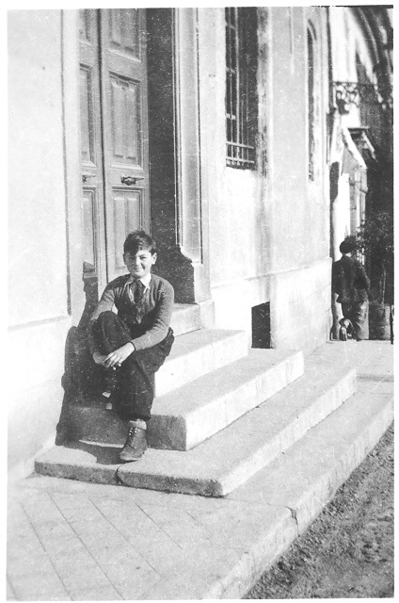
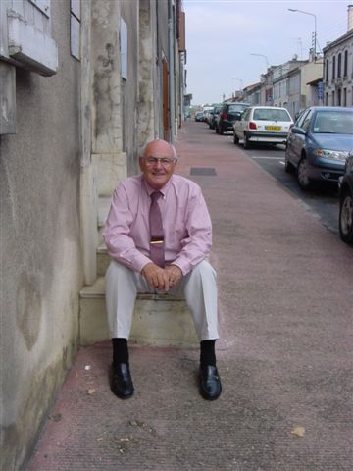
Left: Peter on the family’s doorstep in Auch, France, circa 1941; Right: Peter on same doorstep, 2005. Photos Courtesy of Peter Feigl.

