Slide 1
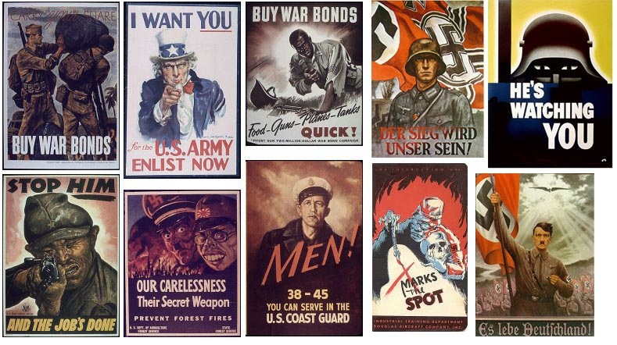
Propaganda – possible other avenues

Slide 2
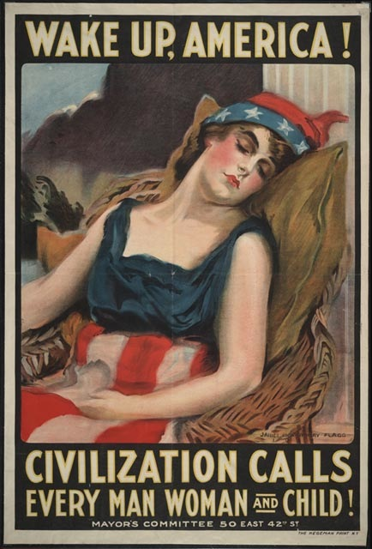
WW I poster
The U.S.A. entered World War One in April 1917, but lost no time in producing many more propaganda posters than any other single nation. These encompassed recruitment to the various armed services, plus - frequently - the raising of war finance via the hugely successful liberty bond issues.

Slide 3
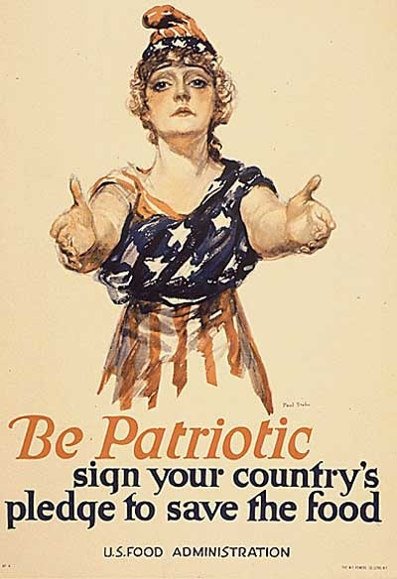
Paul C. Stahr (1883-19??) Be Patriotic New York: W. F. Powers [1918?]
United States WWI Propaganda Poster

Slide 4
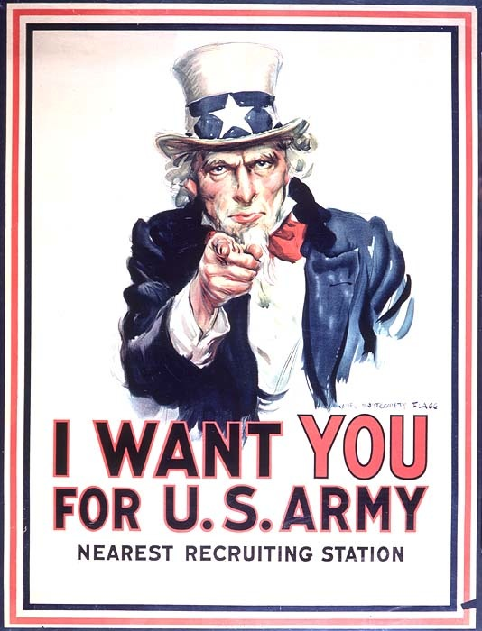
James Montgomery Flagg – “I want YOU for the U.S. Army

Slide 5
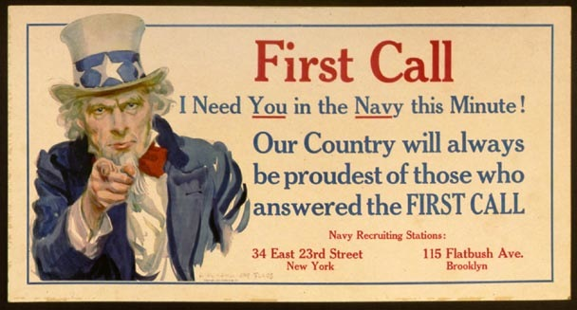
James Montgomery Flagg (1877-1960) First Call [New York] Leslie-Judge Co., ©1917

Slide 6
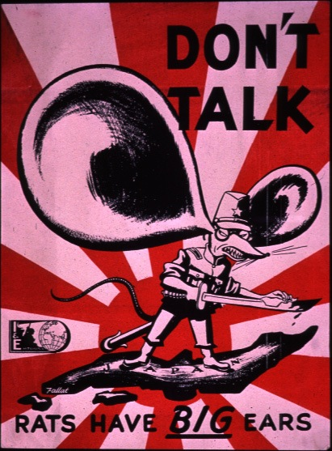
Anti-Japanese Propaganda War Poster
WWII
(American)

Slide 7
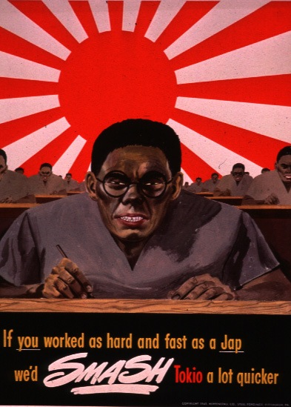
Additional Anti-Japanese Propaganda War Poster
WWII
(American)

Slide 8
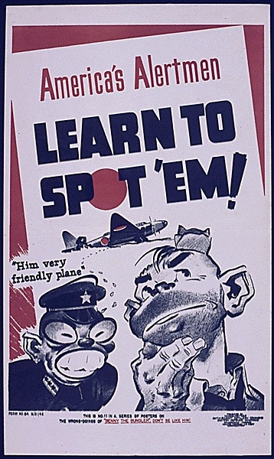
Additional Anti-Japanese Propaganda War Poster
WWII
(American)

Slide 9
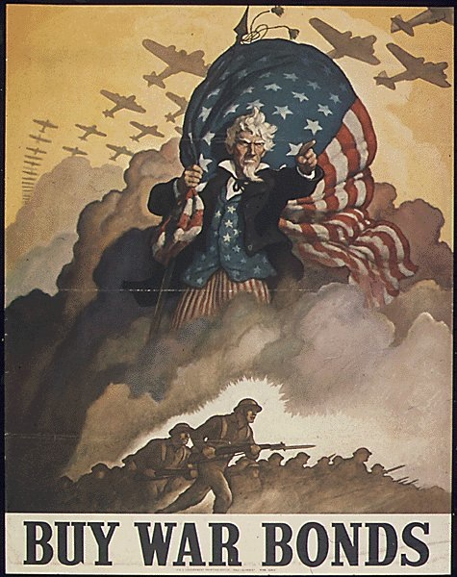
WWII
(American)

Slide 10
WWII
(American)

Slide 11
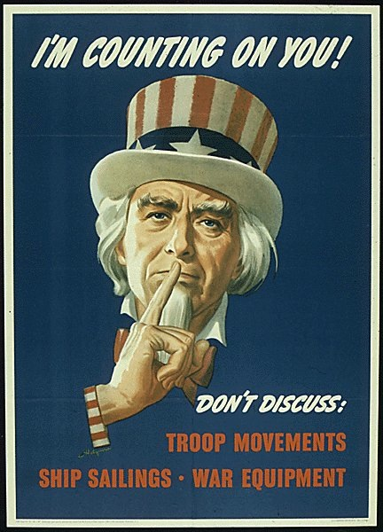
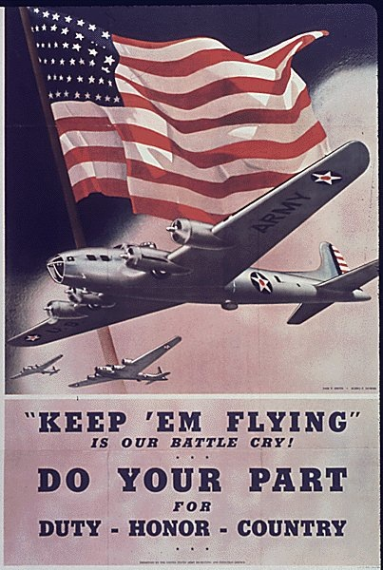
WWII
(American)

Slide 12
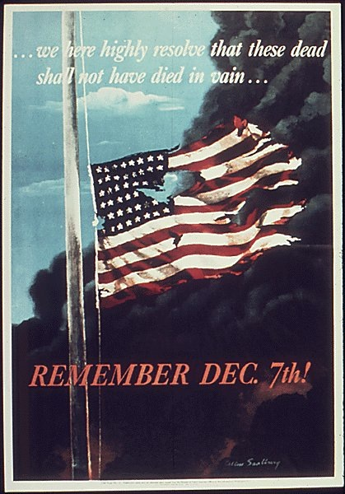
WWII
(American)

Slide 13
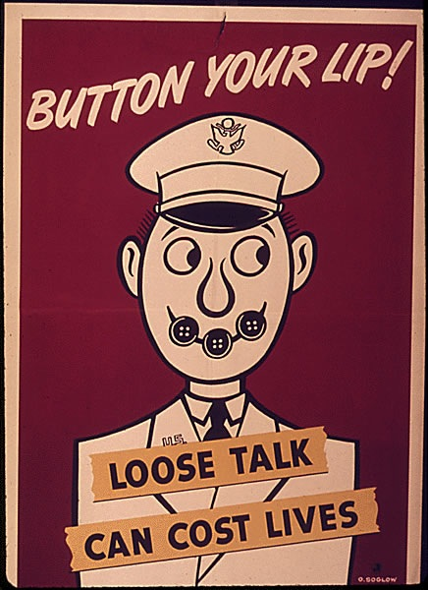
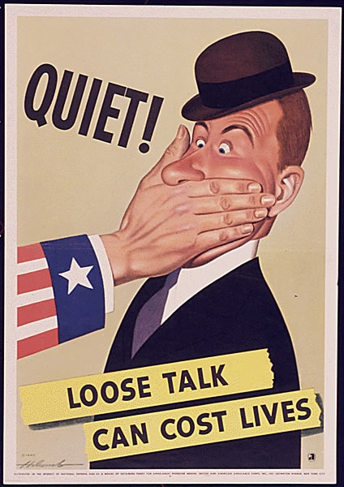
WWII
(American)

Slide 14
WWII
(American)

Slide 15
WWII
(American)
This image plays on the famous "Uncle Sam Wants You" figure on World War I recurring posters. Employers did not expect their work force to take all poster slogans literally. Rather, they may have used some of these posters to create an atmosphere of unity, urgency, and productivity.

Slide 16
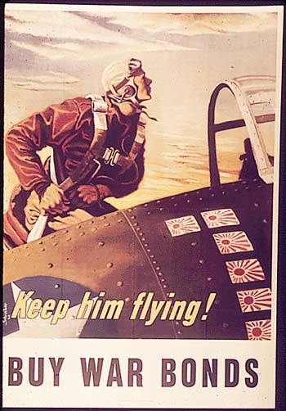
"Keep Him Flying, Buy War Bonds" (1941-1945)
United States WWII Propaganda Poster

Slide 17
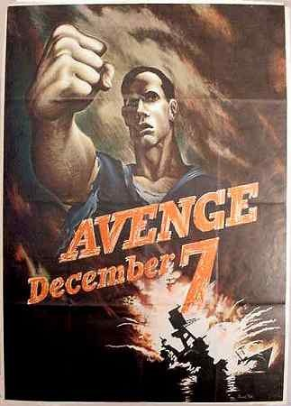
Avenge December 7 Bernard Perlin, U.S. Office of War Information, 1942
United States WWII Propaganda Poster

Slide 18
"Keep These Hands Off, Buy the New Victory Bonds" (1941-1945)
United States WWII Propaganda Poster

Slide 19
We`re Fighting to Prevent This
by C. R. Miller
Think America Institute, Kelly Read & Co. NARA Still Picture Branch (NWDNS-44-PA-2376)
United States WWII Propaganda Poster

Slide 20
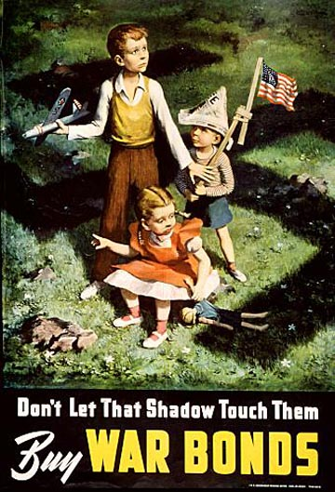
Don`t Let That Shadow Touch Them
by Lawrence B. Smith, 1942
Produced for the Government Printing Office for the U.S. Treasury NARA Still Picture Branch (NWDNS-44-PA-97)
United States WWII Propaganda Poster

Slide 21
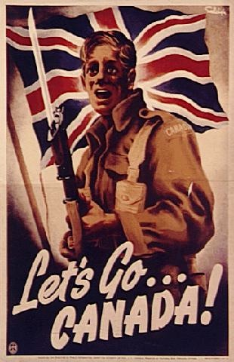
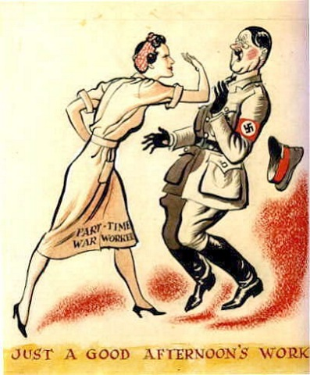
Canadian WWII Propaganda Posters
World War Two Propaganda Posters http://amadeus.management.mcgill.ca/~mark.mortensen/propaganda/15--wwii/X15--wwii-1.html

Slide 22
Canadian WWII Propaganda Posters

Slide 23
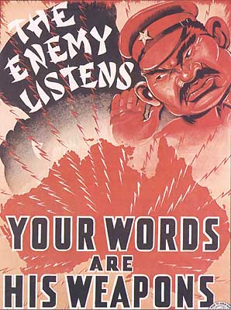
Australian WWII Propaganda Posters

Slide 24
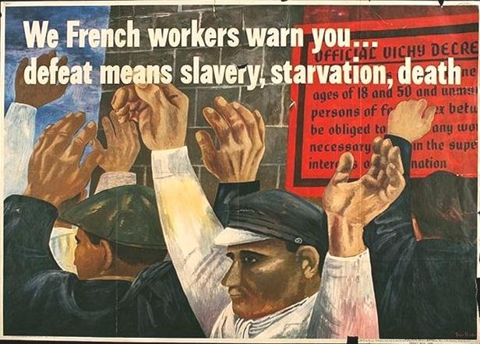
French WWII Propaganda Posters

Slide 25
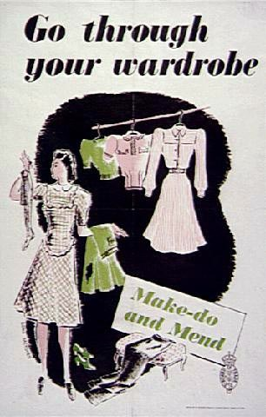
British WWII Propaganda Posters

Slide 26
British WWII Propaganda Poster

Slide 27
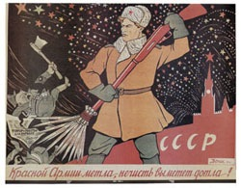
Russian WWII Propaganda Posters

Slide 28
Soviet WWII Propaganda Poster

Slide 29
Questions/ Comments?
Thank you!
M. Lagergren

