Slide 1
The Place:
Terezin, Czechoslovakia
The Time:
1942 - 1945
Notes:
Terezin, also known as Theresienstadt, was a small Czechoslovakian town located near the German border. Terezin was originally built as a fortress town to protect the Czechoslovakian border. The German army invaded Czechoslovakia, and in Nov. 1941 created a prison camp/ghetto for Jews at Terezin. Starting in 1942, Jews from towns all over Europe were arrested and deported by train to Terezin. Thousands died of disease and starvation, and thousands more were sent on to the Nazi death camps.

Slide 2
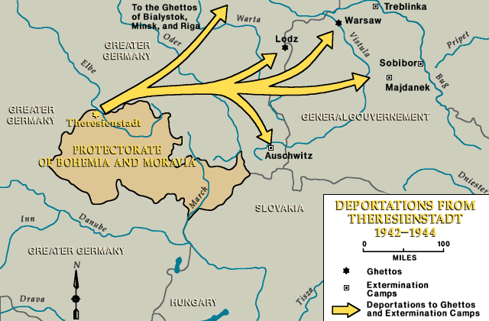
2
Notes:
Terezin is the Czech name for this town, which is also known by its German name, Theresienstadt. This map shows the location of Terezin, near the German border.
Terezin was not a permanent prison for thousands of Jews held there. Those who did not die of disease and starvation at Terezin, were eventually sent further east to death camps in Poland. These camps were places designed to kill thousands of prisoners. The yellow arrows show the routes to the death camps.

Slide 3
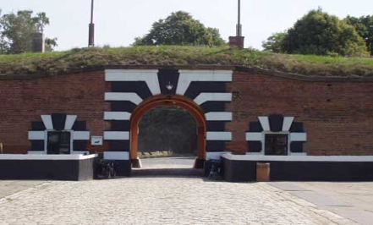
Main entrance to the Little Fortress of Terezin.
Notes:
This is a view many prisoners saw when they arrived at Terezin. 144,00 people were deported to Terezin. Of these, 33,000 died here of starvation and disease. 90,000 others were sent east to death camps.

Slide 4
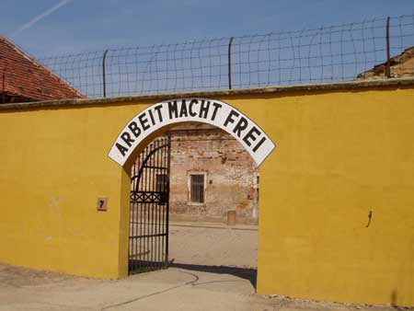
Entrance to Small Fortress of Terezin camp. The gate bears the motto “Arbeit Macht Frei” (Work makes one free) .
Notes:
This is the entrance to the prison area of Terezin. Jews who tried to resist the Nazis were kept here.

Slide 5
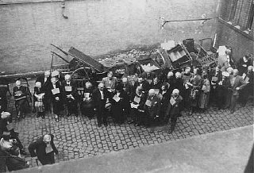
German Jews, wearing identification tags, before deportation to Theresienstadt. (Wiesbaden, Germany, August 1942)
__________
Bildarchiv Preussischer Kulturbesitz
Notes:
The Gestapo (German Police) would gather up groups of Jews, and transport or march them to the railroad station.

Slide 6
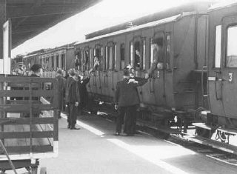
Departure of a train of German Jews being deported to Theresienstadt. (Hanau, Germany, May 30, 1942)
__________
Bildarchiv Preussischer Kulturbesitz
Notes:
The Jewish prisoners were crowded into railroad cars, often to the point that everyone had to stand for for the journey.

Slide 7
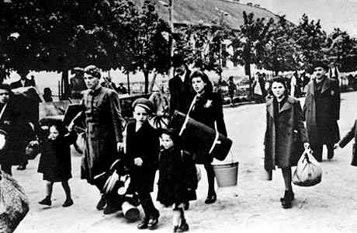
The arrival of Jews at the Terezin (Theresienstadt) Ghetto, near Prague, Czechoslovakia.
Source: Shoah - The Holocaust
Notes:
Prisoners were sometimes allowed to bring a few possessions with them, but often what they brought was immediately taken away by the prison guards.

Slide 8
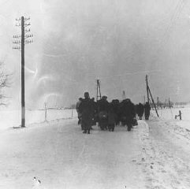
A transport of Jewish prisoners marches through the snow from the Bauschovitz train station to Theresienstadt.
(Czechoslovakia, 1942)
__________
Jewish Museum of Prague
Notes:
Even in the worse weather, young and old alike were forced to march from the train station to the Terezin ghetto.

Slide 9
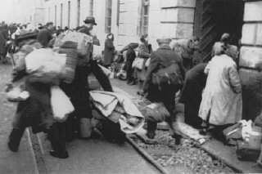
Arrival of a transport of Dutch Jews in the Theresienstadt ghetto.
(Czechoslovakia, February 1944)
__________
United States Holocaust Memorial Museum

Slide 10
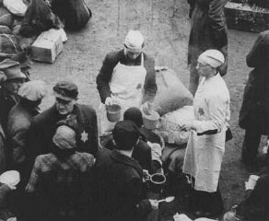
Dutch Jews who have recently arrived in the Theresienstadt ghetto. Czechoslovakia, February 1944.
__________
United States Holocaust Memorial Museum

Slide 11
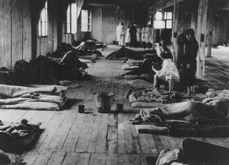
Women prisoners lie on thin mattresses on the floor of a barracks in the women's camp in the Theresienstadt ghetto. Czechoslovakia, between 1941 and 1945.
__________
YIVO Institute for Jewish Research
Notes:
The living conditions were quite miserable, and were usually very crowded.
Sicknesses spread quickly among the people.

Slide 12
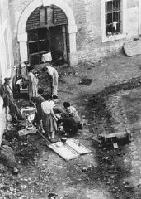
Preparation of food in the Theresienstadt ghetto. (Theresienstadt, Czechoslovakia, between 1941 and 1945.)
__________
YIVO Institute for Jewish Research
Notes:
The food for the prisoners was very poor quality and was prepared in unsanitary conditions. Food rations were very small.

Slide 13
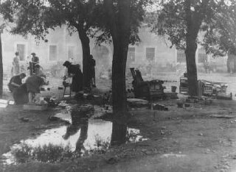
Women prepare food outdoors in the Theresienstadt ghetto. Theresienstadt, Czechoslovakia, between 1941 and 1945.
__________
YIVO Institute for Jewish Research
Notes:
Cooking generally happened outdoors at Terezin.

Slide 14
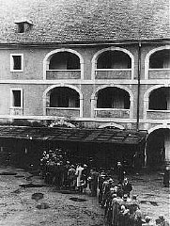
Prisoners wait for food rations. Theresienstadt ghetto, Czechoslovakia, between 1941 and 1945.
__________
YIVO Institute for Jewish Research
Notes:
Prisoners at Terezin were always hungry. Thousands died of malnutrition.

Slide 15
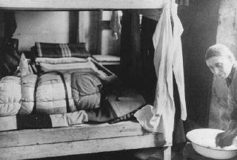
Living quarters in the Theresienstadt ghetto. (Theresienstadt, Czechoslovakia, between 1941 and 1945.)
__________
YIVO Institute for Jewish Research
Notes:
The Nazis claimed that Terezin was a model town for relocated Jews. They made sure that International Red Cross inspectors never saw the real living conditions of the prisoners. They built fake barracks, painted buildings and planted flowers to fool the inspectors into thinking that Terezin was a “normal” town.

Slide 16
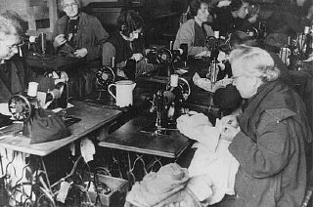
Forced laborers at work in a tailor's workshop. Theresienstadt ghetto, Czechoslovakia, between 1941 and 1945.
__________
YIVO Institute for Jewish Research
Notes:
Men, women and children were forced to work for long hours. However, the children at Terezin were allowed to go to school. Adult prisoners acted as their teachers, and tried hard to make life as normal as possible for the children.

Slide 17
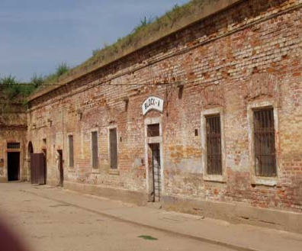
Prisoner cell block A at the
Little Fortress of Terezin.

Slide 18
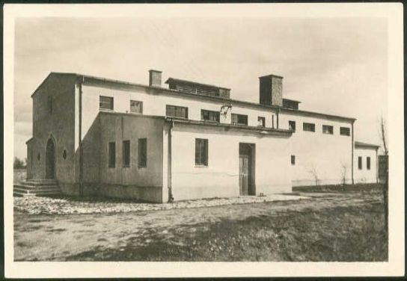
Crematorium at Terezin.
Notes:
The Nazis build crematoriums to dispose of the dead. The Nazis tried to hide the fact that they killed millions of people. Red Cross Inspectors would never have seen this place.

Slide 19
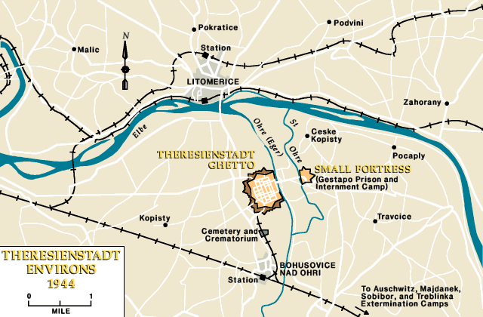
Notes:
Here is a layout of the town. The ghetto is area is where most of the prisoners lived in barracks. The prison and internment camp were where political prisoners and Jewish resisters were held.

Slide 20
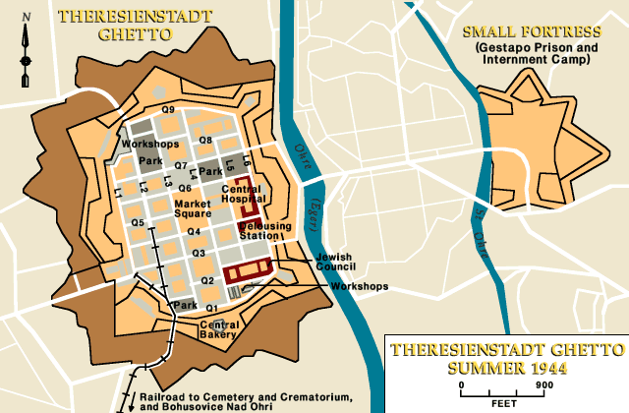
Notes:
A closer view of the Terezin ghetto area. Although, the Jews lived in crowded, often miserable conditions, they tried hard to create normal lives for themselves and the children. Many Jewish artists, musicians and writers were prisoners here, so Terezin had a strong cultural life. In spite of the conditions.

Slide 21
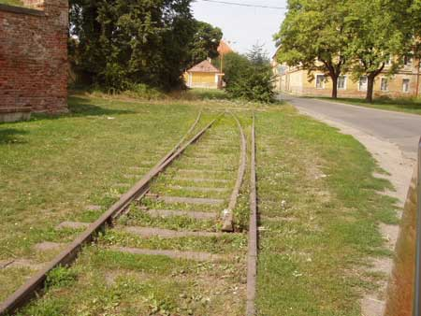
Tracks that once carried trainloads of Jews to the ghetto of Terezin.
Notes:
Here are the old railroad tracks that carried thousands of human beings to their deaths.

Slide 22
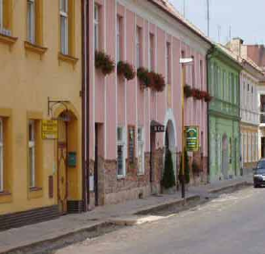
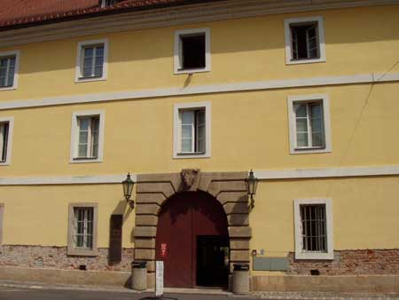
Inside the former ghetto of Terezin. Today, it is a residential area.
This building now is a museum containing ghetto artifacts.
Notes:
Buildings that once were crowded with prisoners, are now private homes and businesses.

Slide 23
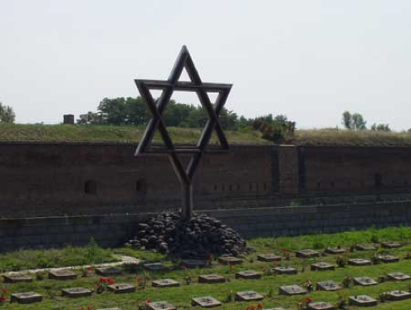
Symbolic cemetery at the Little Fortress for the victims of Terezin. The identities of those buried is unknown.
Notes:
The ashes of bodies found after Terezin was liberated in 1945 by the Allied Armies, were buried here.

Slide 24
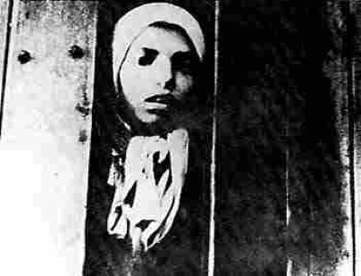
A total of around 15,000 children under the age of 15 passed through Terezin, of these around 100 came back.
Notes:
Very few children lived to tell about their experiences at Terezin. In fact, most of the world never knew about what happened at Terezin until the 1990s. Why was the truth hidden for so long?

Slide 25
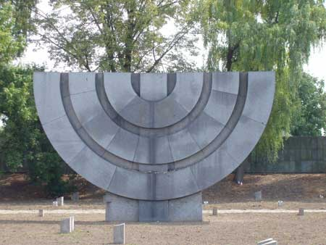
Monument to the victims of Terezin.
Notes:
The memorial at Terezin is now open to the public. It is hoped that remembering the suffering of those who lived here, will help prevent such things from happening again.

Slide 26
Informational and pictorial source for this slideshow:
“Theriesenstadt.” Holocaust Encyclopedia. Washington, D.C.: Holocaust Memorial Museum, available at: http://www.ushmm.org

